Slide 1
Kongsberg Maritime
ExxonMobil
Hammerhead Flexible Riser Slug Fatigue Study

Slide 2
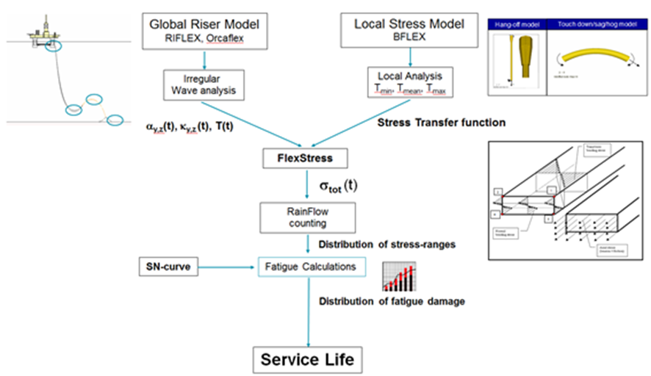
Slug Fatigue - Scope
Slugging mixture density series data will be provided for different longitudinal locations of the riser.
6 flow scenarios
Global analysis of 6 flow scenarios. A 3-hour simulation will be run to find the hot spots for further local fatigue analysis.
A local BFLEX model will be developed to calculate the tension and curvature to stress transfer functions
Flexstress is used to determine the stress time series from the curvature time series and calculate fatigue damage for each flow scenario.

Slide 3
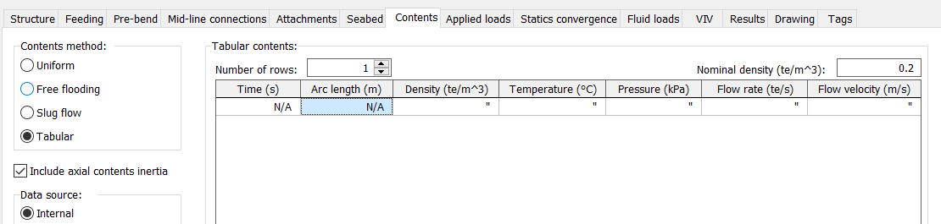
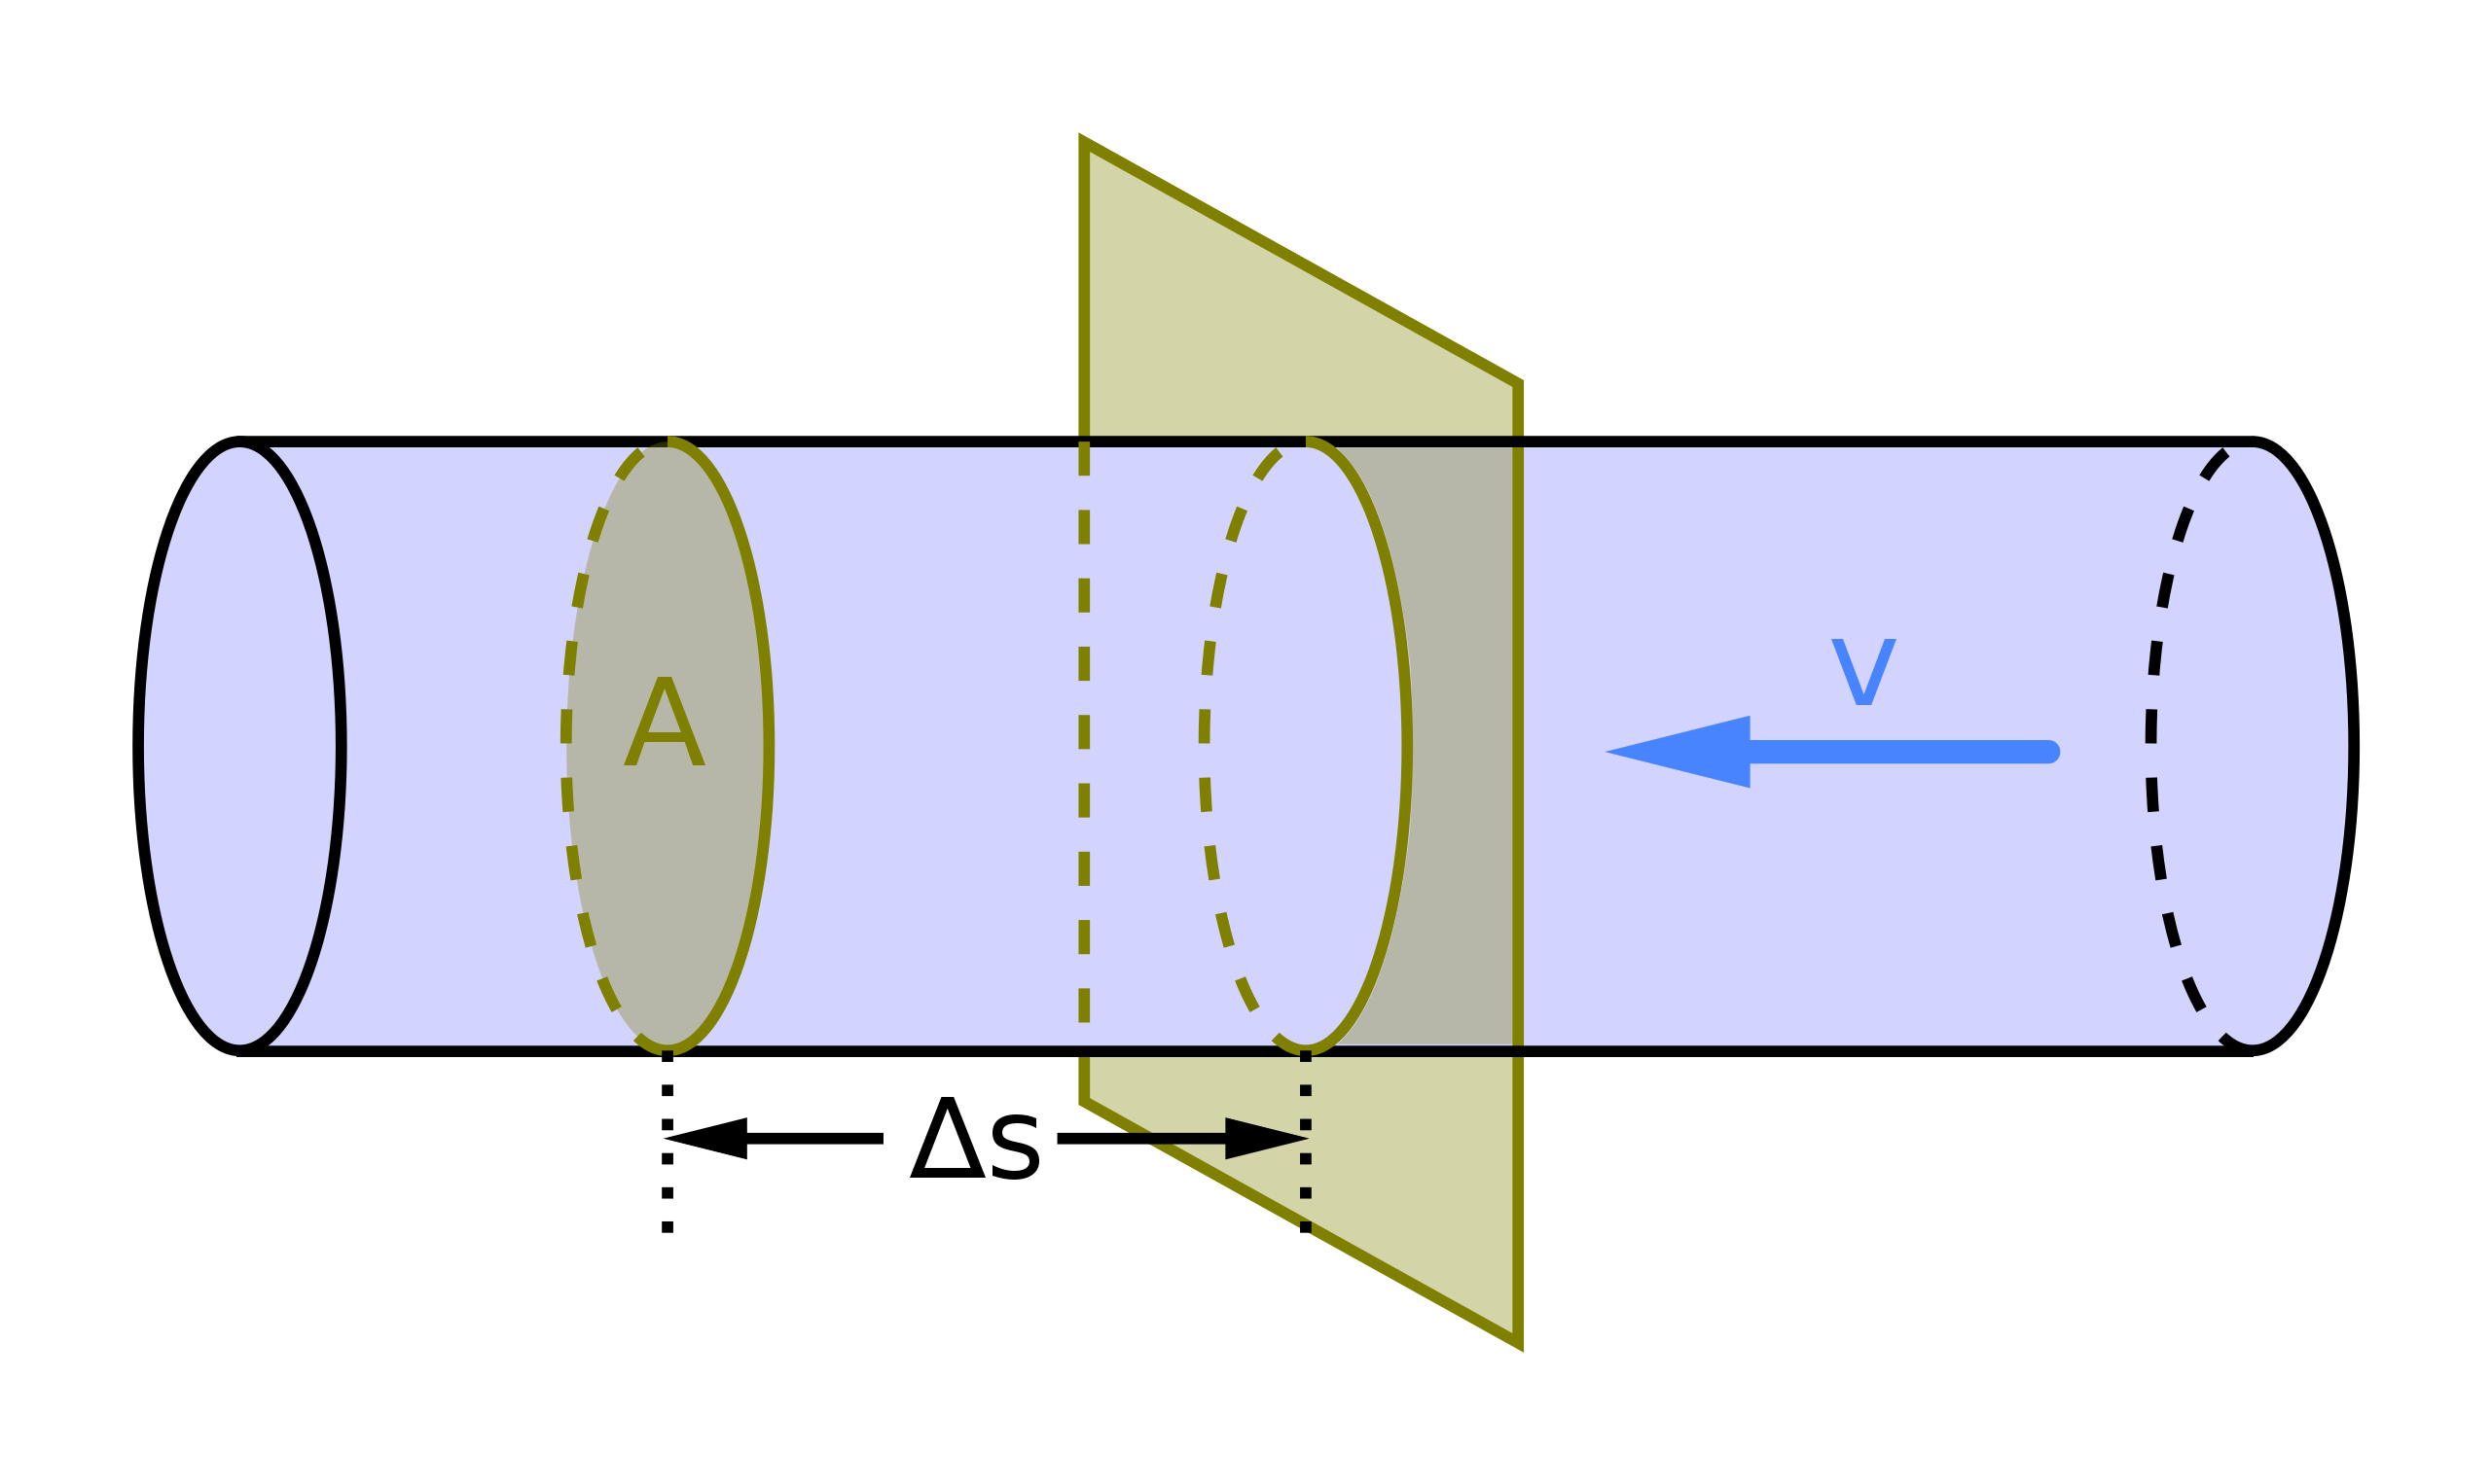
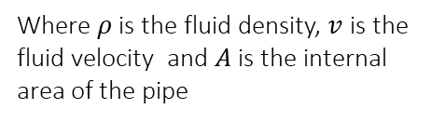
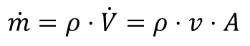
Slug Global Analysis – Input required
Orcaflex model of the riser configuration
Flexible riser cross section data
SN curve
Slug input:
- time
- arc length
- mixture density
- flow rate
- avg slug front velocity
Insert txt to Orcaflex
Run Simulation
Global Analysis
Flow rate can be calculated according to:
$$\dot{m}=ρ⋅\dot{V}=ρ⋅v⋅A$$
Where $ρ$ is the fluid density, $v$ is the fluid velocity and $A$ is the internal area of the pipe

Slide 4
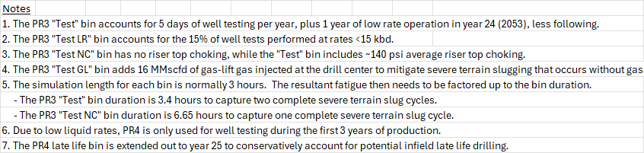
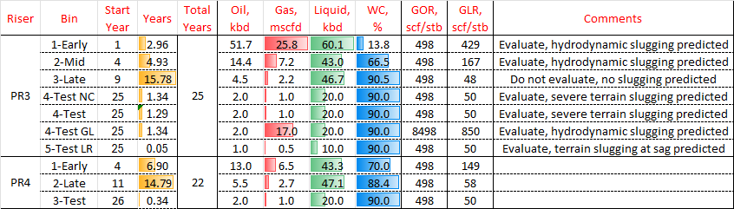
Slug data
OLGA profile plot data files contains for every second:
ROG (gas density)
ROL (liquid density)
HOLEXP (liquid holdup fraction)
USFEXP (slug front velocities at section boundaries)
Mixture density can be calculated as:
ROM=ROG*(gas holdup fraction) +ROL*HOLEXP
Flux volume velocity was used as input to Orcaflex

Slide 5
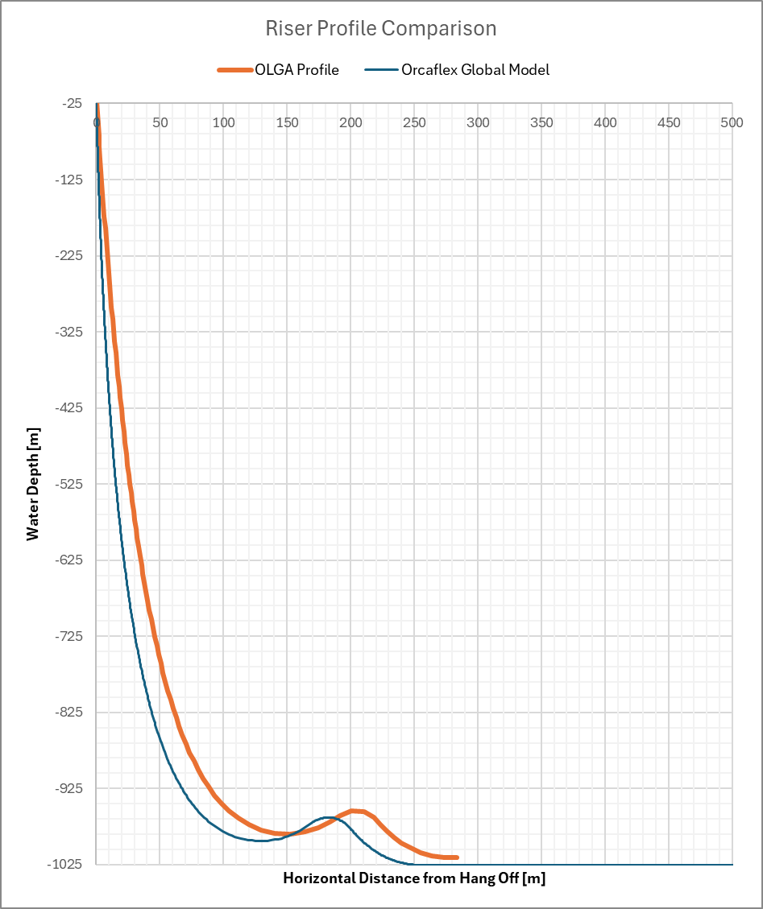
Riser Configuration and Annulus Conditions
Orcaflex model was adjusted to match OLGA
Operational pressure profile for local fatigue analysis provided by ExxonMobil
Conservatively used the highest pressure at hot spots
SN curve 1bar CO2
Annulus condition:
Intact and dry (in air)
Intact and wet
Outer sheath damage/flooded and wet

Slide 6
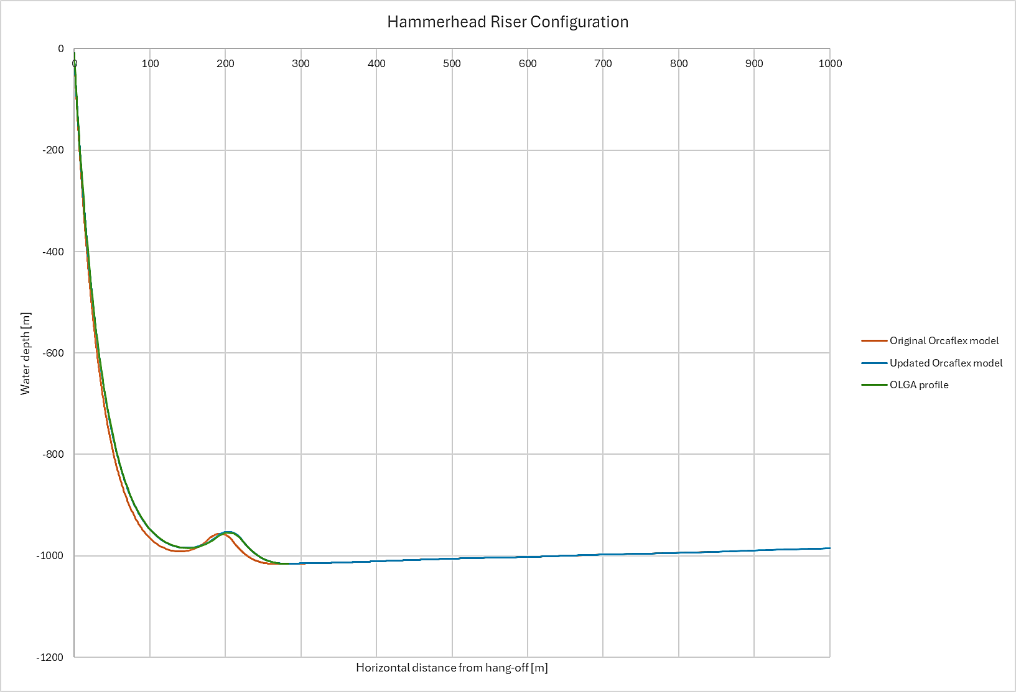
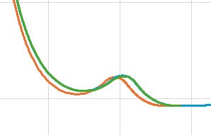
Riser Configuration – Orcaflex model
Adjustments made to the Orcaflex riser configuration to match the OLGA profile:
Removed 10m riser length from the upper catenary
Added 3m to the lower catenary
Added static riser length on the seabed up to the drill center
Added seabed slope according the excel sheet “FR-Jan2025-HH2-PR3”
Other adjustments:
Drag coefficient, changed from 1.8 to 0.7
Structural damping 1.5% added
Change mesh to 0.25m at TDP

Slide 7
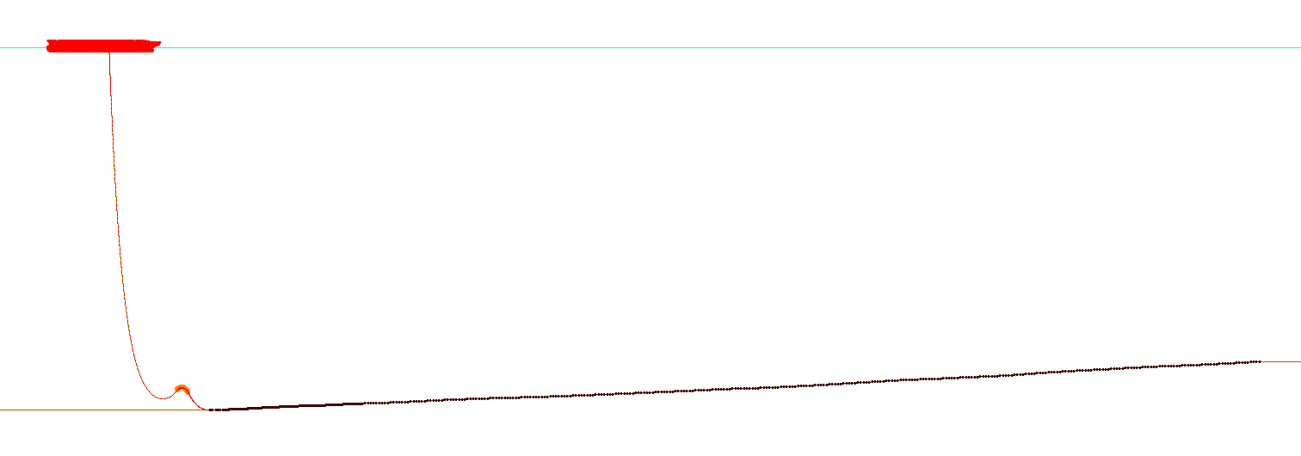
Riser Configuration – Orcaflex model
FPSO
Water depth:
1015.61m
Water depth:
881m
Drill center
Distance hang-off to TDP: 280m
Distance TDP to Drill center: 2940m
More detailed view of the seabed slope
Water depth [m]

Slide 8
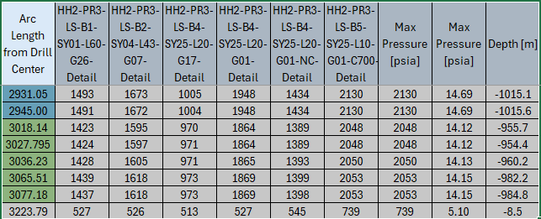
Slug Fatigue Analysis
Premise:
6 flow conditions were analyzed
Intact and flooded annulus condition
Hysteretic bending stiffness considering flooded and intact annulus is considered for the global analysis (one-to-one with local analysis).
Pressure profile is provided for each bin. Max operating pressure out of all the bins in the TDP, buoyancy and hang off sections are chosen for the analysis.
Total flux volume velocity is used in Orcaflex.
KM is using the Tabular contents feature available in Orcaflex 11.4
Pressures used in Local Analysis
TDP | 14.69
HOG/SAG | 14.14
Bend Stiff | 5.10

Slide 9
Conservatism in the Pressure Selection
Internal pressure increases the friction stress in the pipe and hence by choosing the max pressure and applying that for all the bins is a conservative approach.
Three fatigue dominant flow conditions (see table below) have lower operating pressures compared to max pressure. Using correct pressure for the respective bins would increase the fatigue life.
Pressures used in Local Analysis
TDP | 14.69
HOG/SAG | 14.14
Bend Stiff | 5.10
Bin | Internal Pressure |  | Individual Damage per Year ¹⁾ |  | Individual Fatigue Life (SF=10)
 | Actual Pressure | Used Pressure | Intact | Flooded | Intact | Flooded
HH2-PR3-LS-B2-SY04-L43-G07-Detail (Bin 2 Mid) | 11.5 | 14.69 | 1.13E-03 | 3.93E-04 | 88 | 255
HH2-PR3-LS-B4-SY25-L20-G01-NC-Detail (Bin 4-Test NC) | 9.9 |  | 5.84E-03 | 1.95E-05 | 17 | 5124
HH2-PR3-LS-B4-SY25-L20-G17-Detail (Bin 4-Test GL) | 6.9 |  | 6.16E-03 | 9.33E-04 | 16 | 107

Slide 10
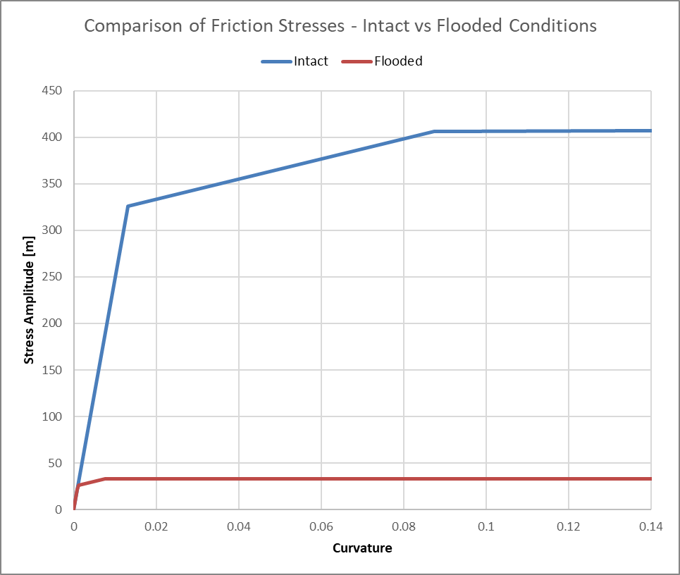
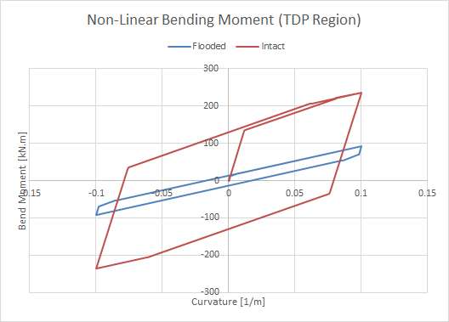
Slug Fatigue Analysis
Local cross-sections are modelled in Bflex. Friction coefficient of 0.15 is used across all the layers in Bflex model.
Hysteresis models and Stress transfer functions are generated in Bflex.

Slide 11
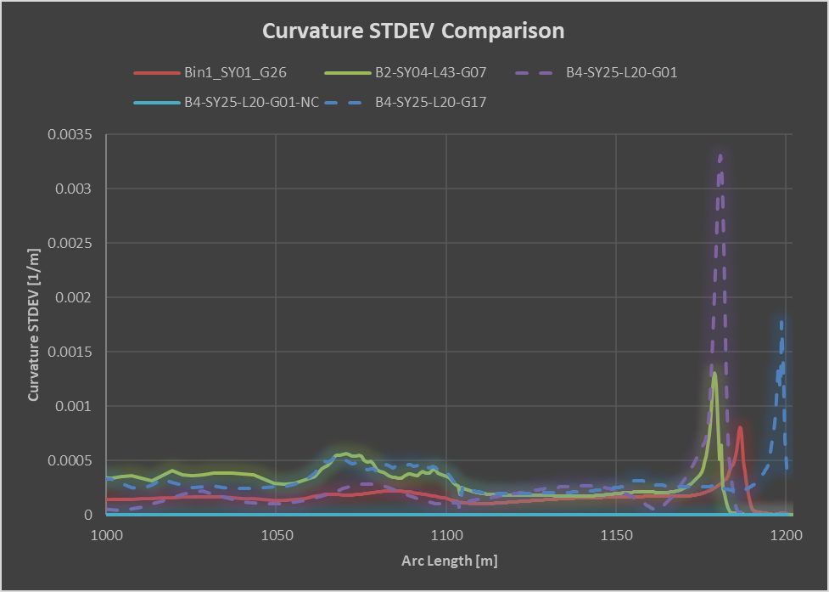
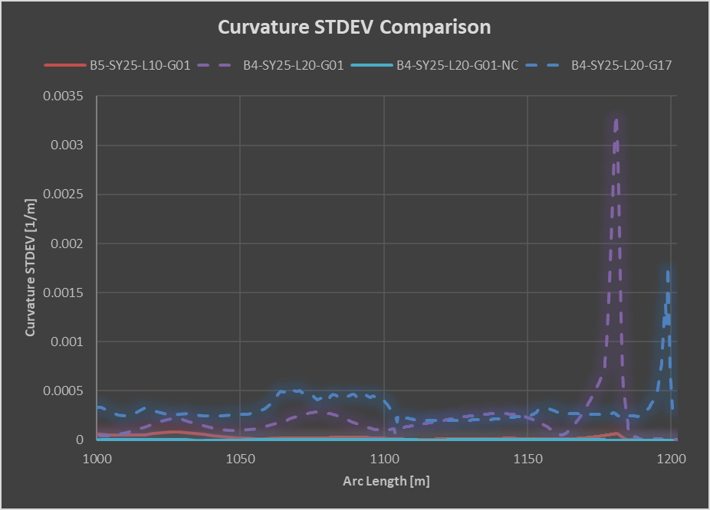
Slug Fatigue Analysis
From global fatigue analysis TDP region is identified as fatigue hotspot.

Slide 12
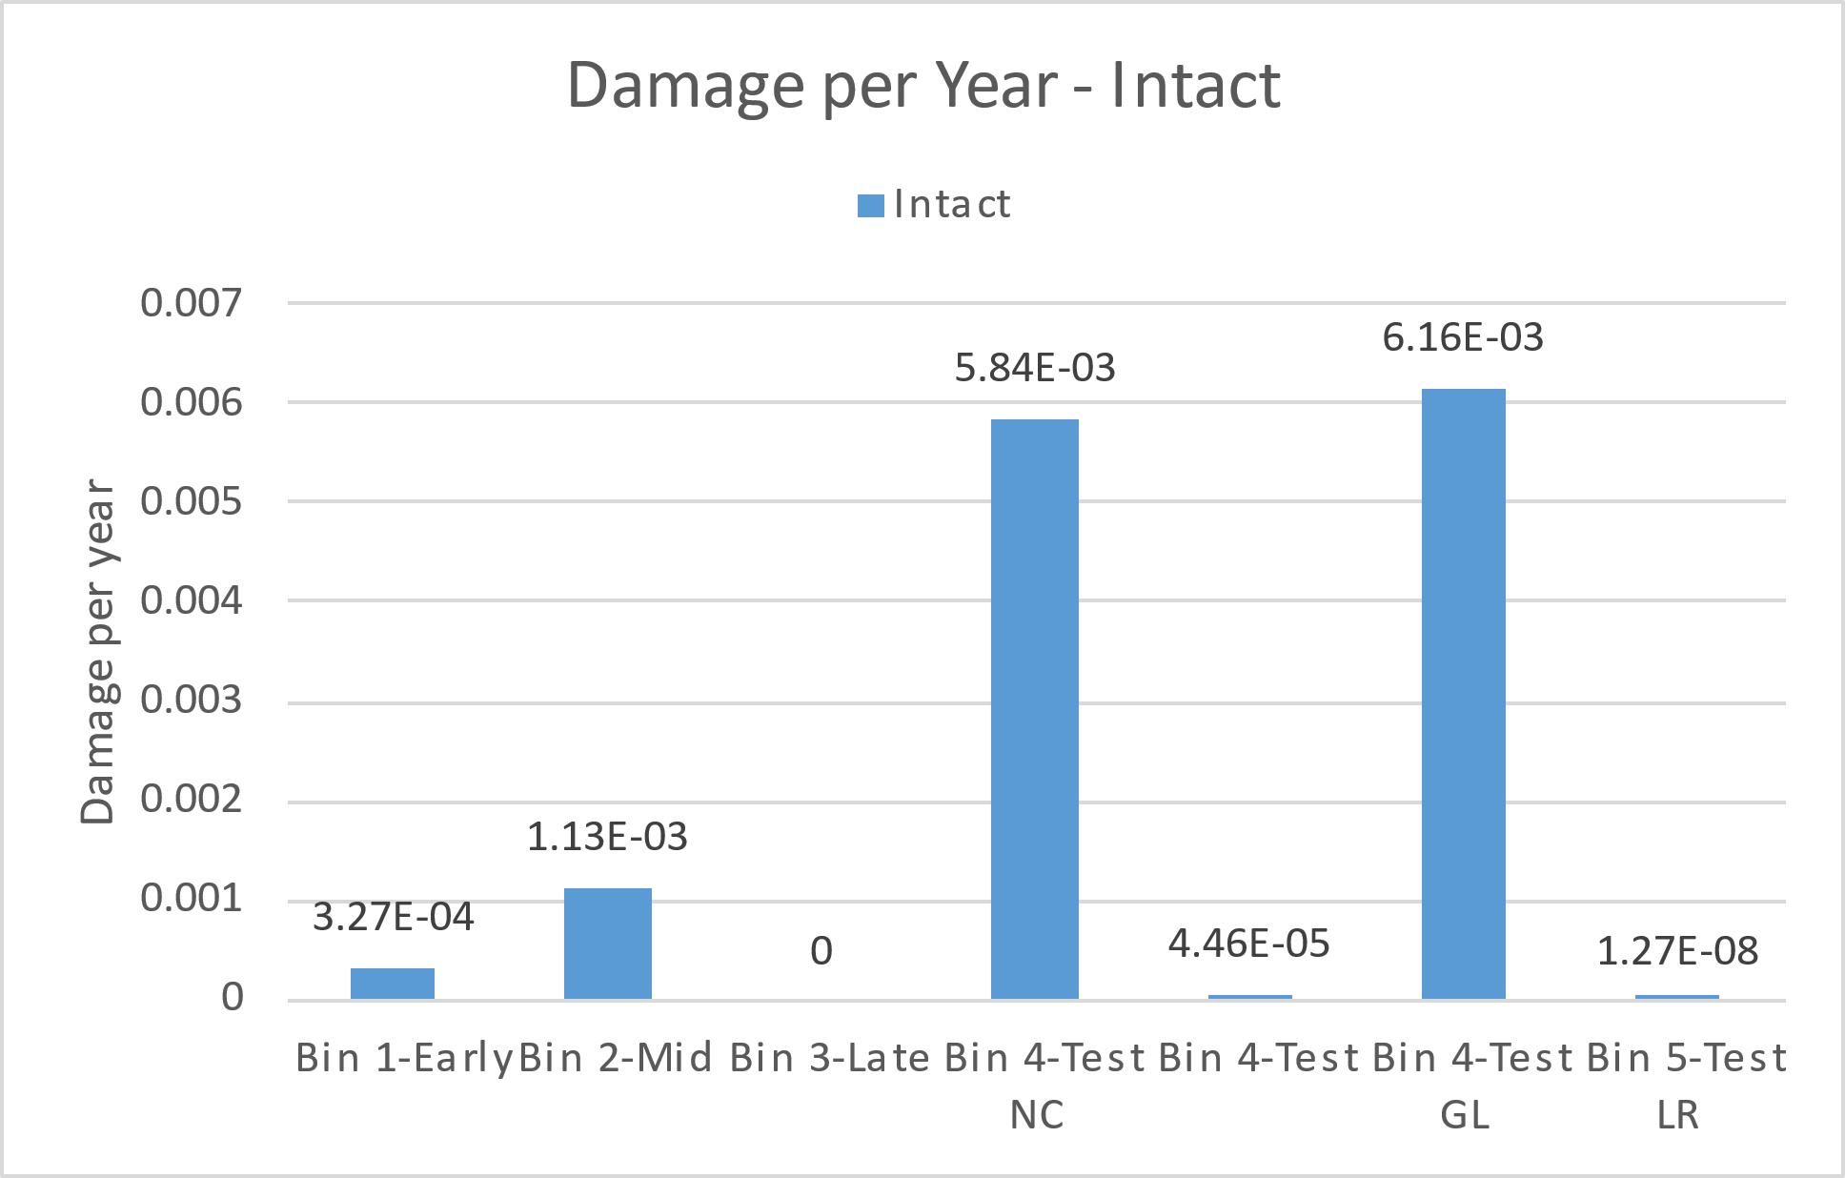
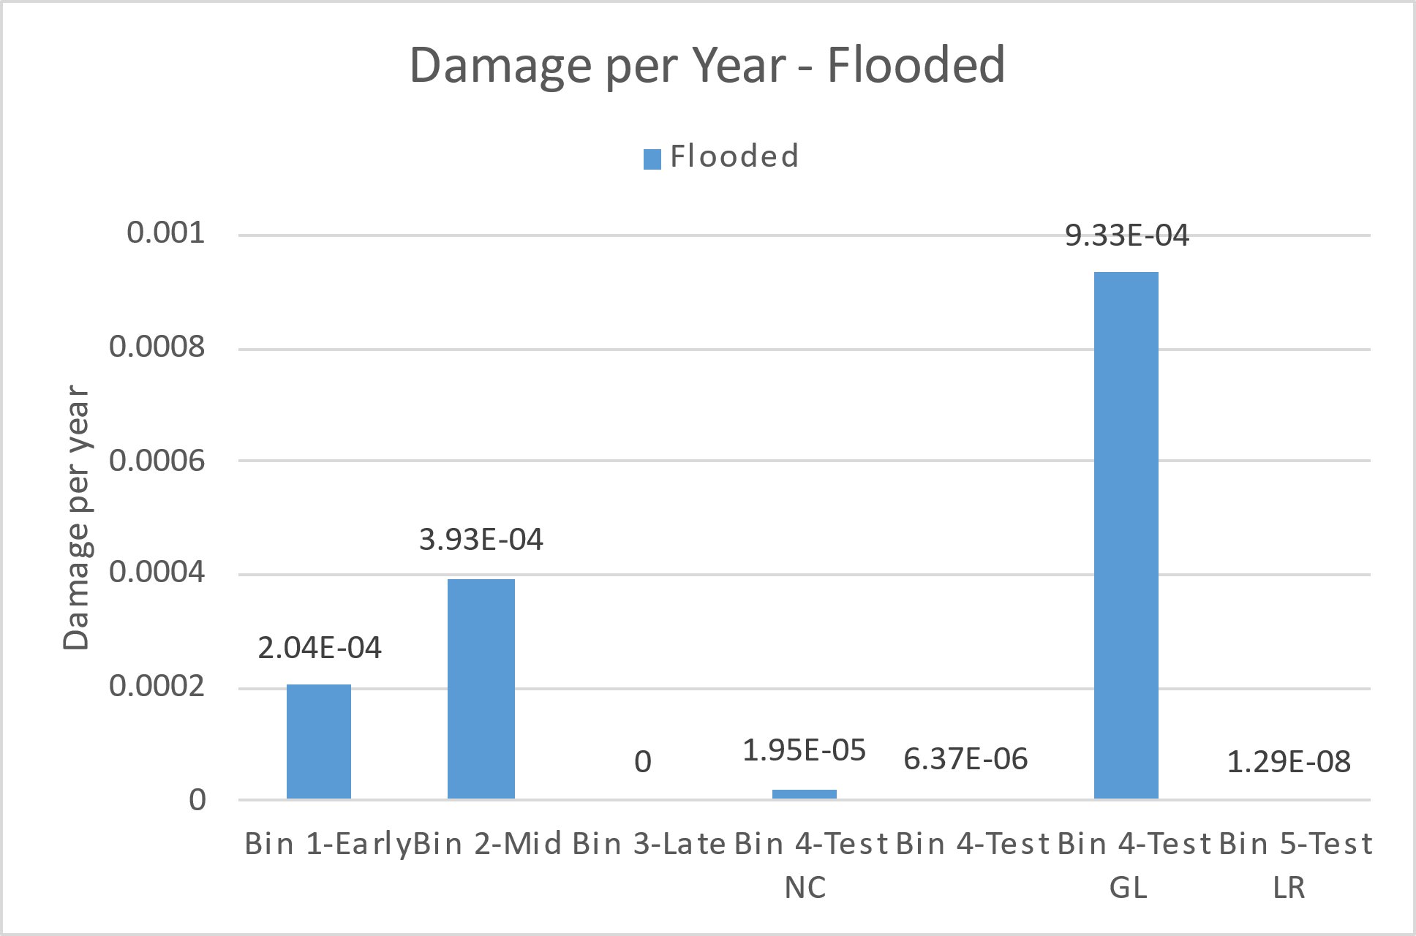
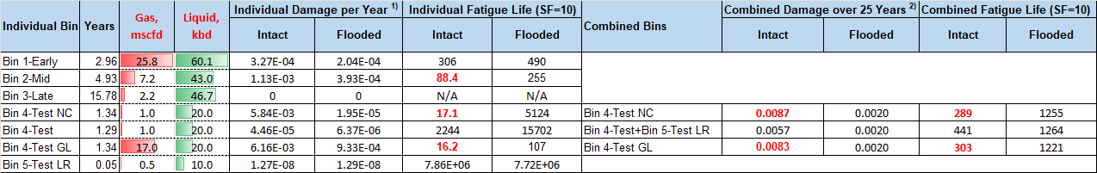
Slugging Results – Damage per bin
Assume 1bar CO2 SN curve
Highest fatigue damage rates:
Bin 2-Mid: Start Year 4
Bin 4-Test NC: Non-choking case with terrain slugging
Bin 4-Test GL: Gas injected to mitigate severe terrain slugging
Note that: 1) Individual fatigue damage is with 100% probability at individual arc length hot spot. 2) The combined fatigue damage/life includes the probability for each bin and arc length hot spot is determined by combining all the relevant bins.

Slide 13
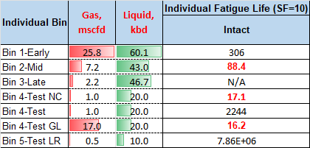
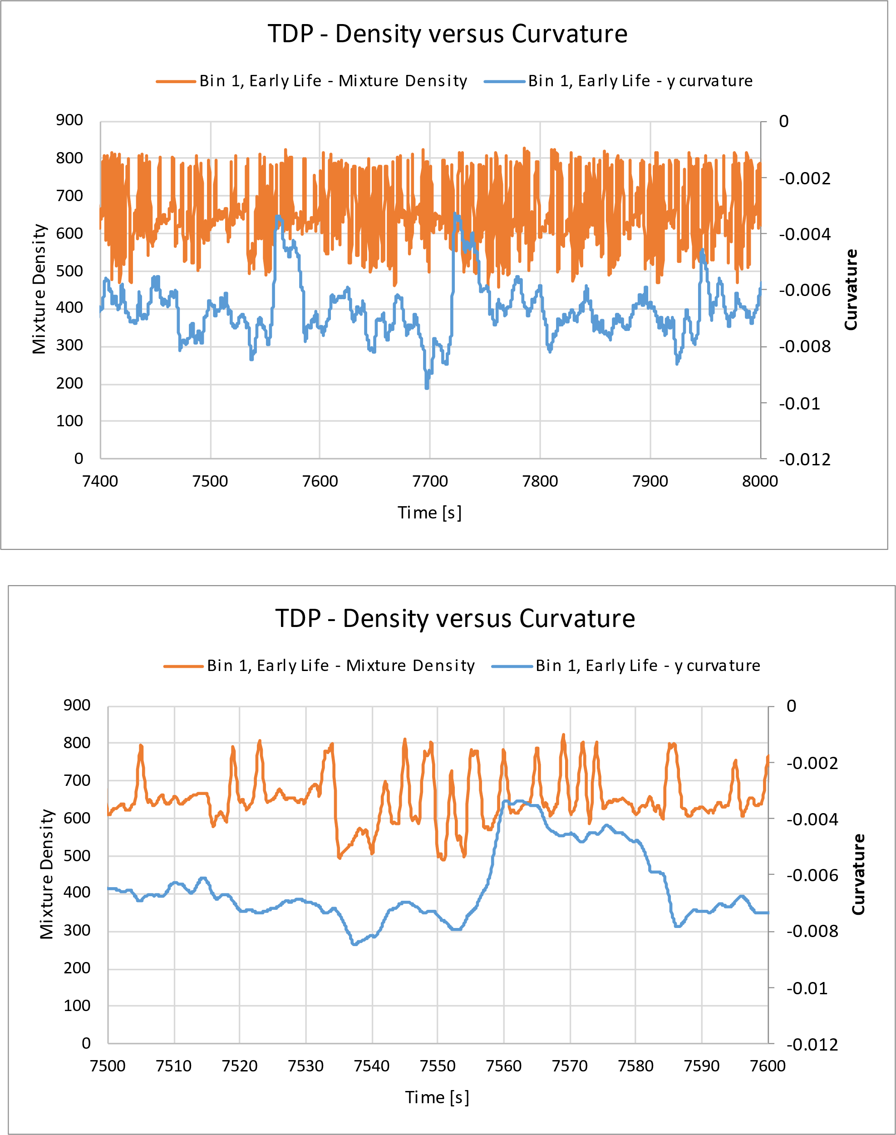
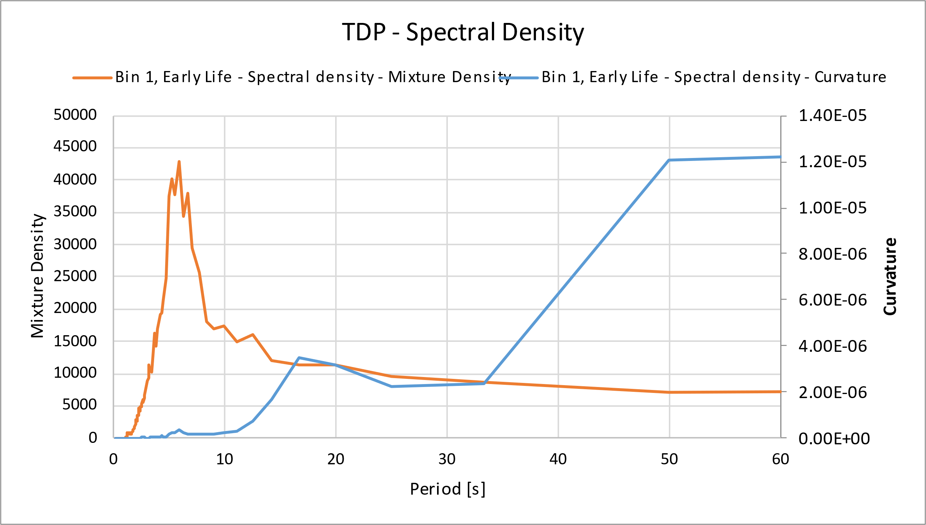
Global TDP Slugging Response
Bin 1 Early Life: Hydrodynamic slugging
Low fatigue life
Note that global curvature responses are with flooded global hysteresis

Slide 14
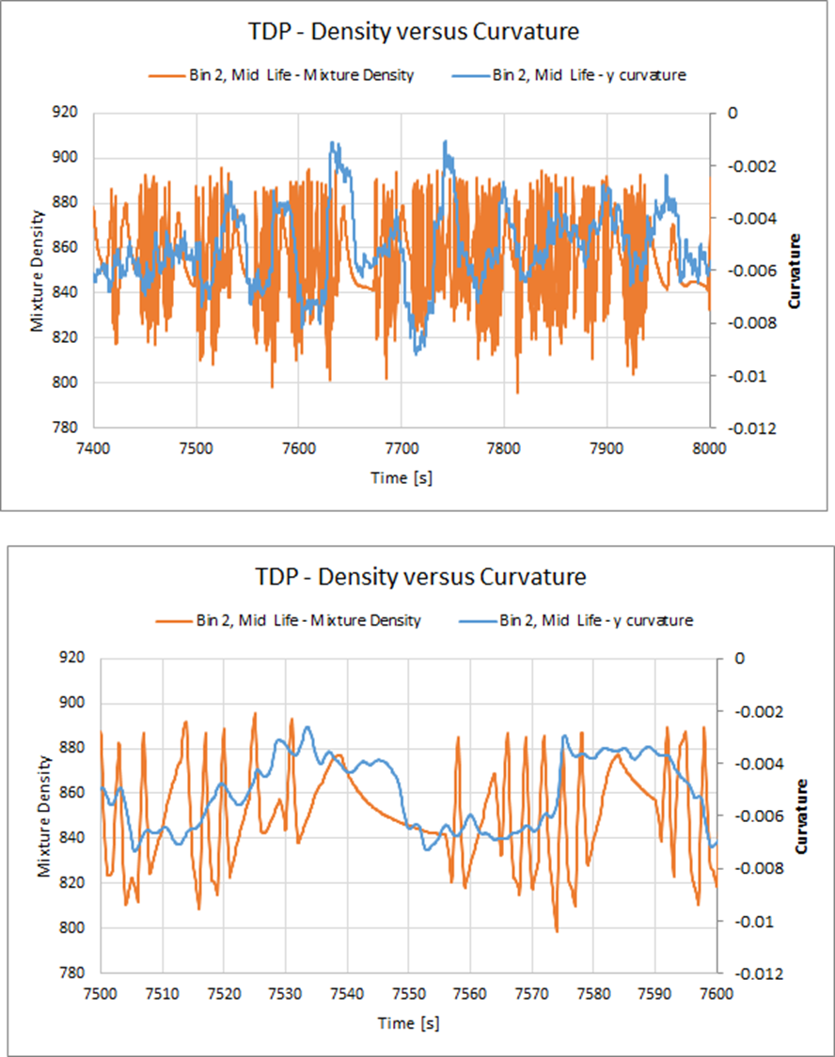
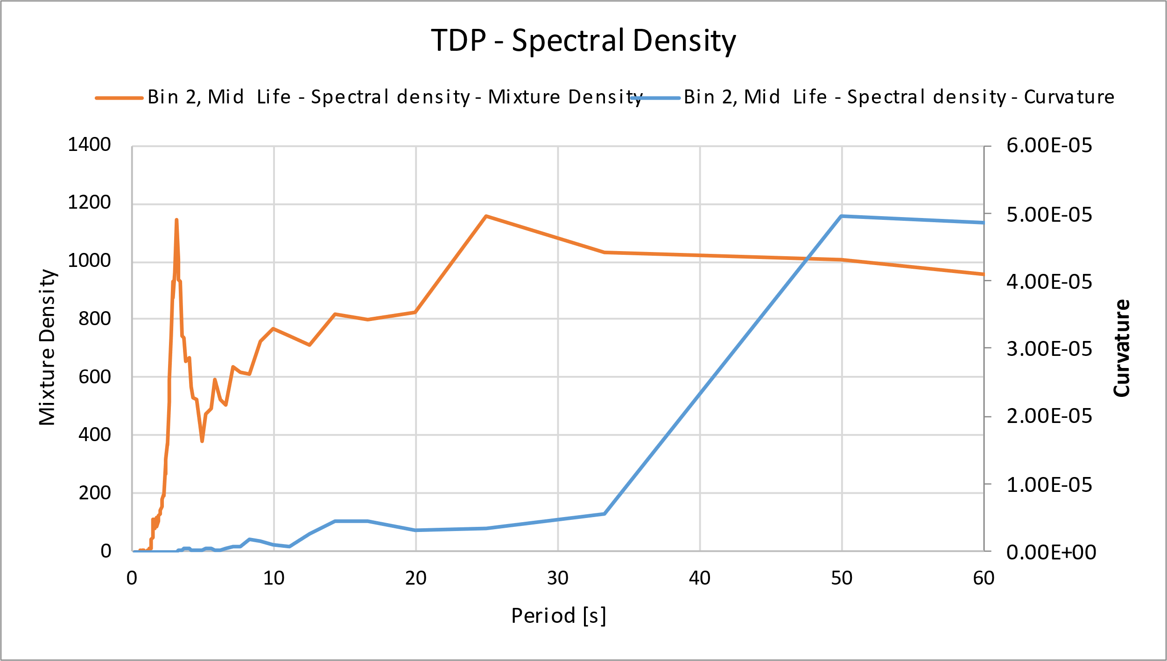
Global TDP Slugging Response
Bin 2 Mid Life: Hydrodynamic slugging
Low fatigue life
Note that global curvature responses are with flooded global hysteresis

Slide 15
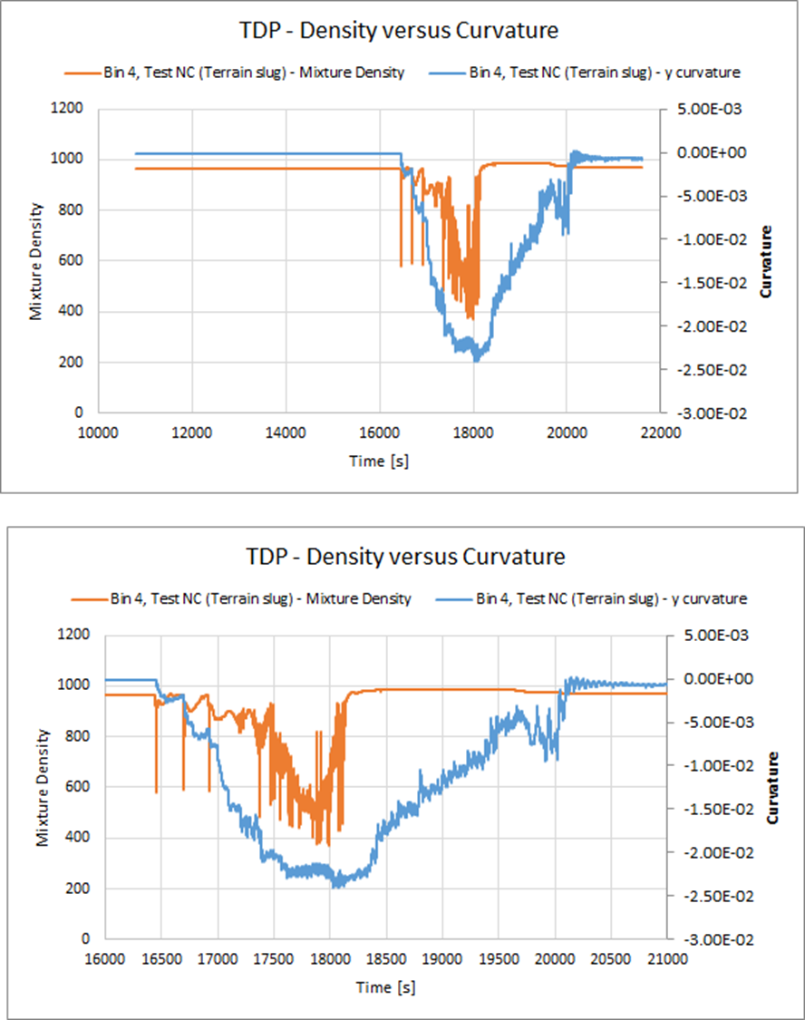
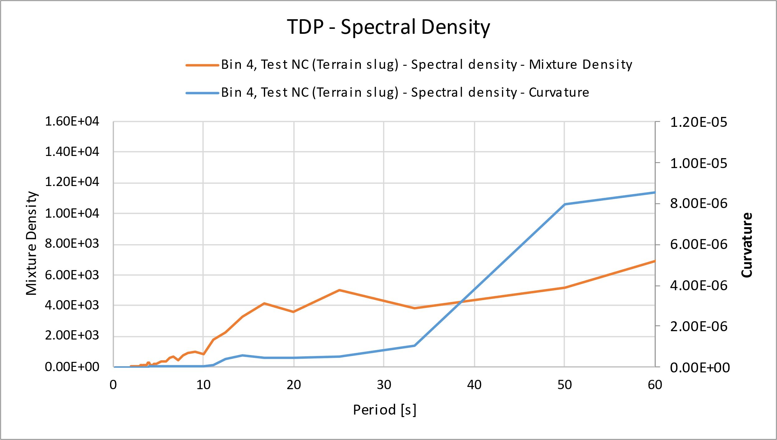
Global TDP Slugging Response
Bin 4 Test NC: Terrain slugging
Low fatigue life
One slug during 6.4 hours.
Note that global curvature responses are with flooded global hysteresis

Slide 16
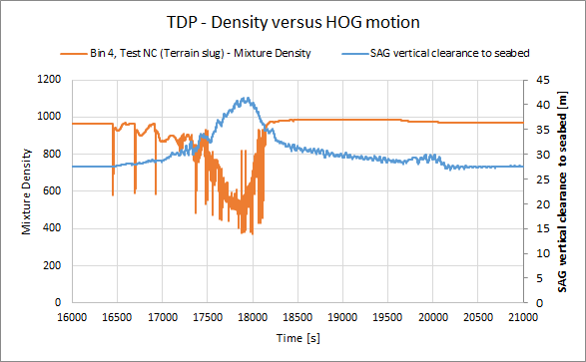
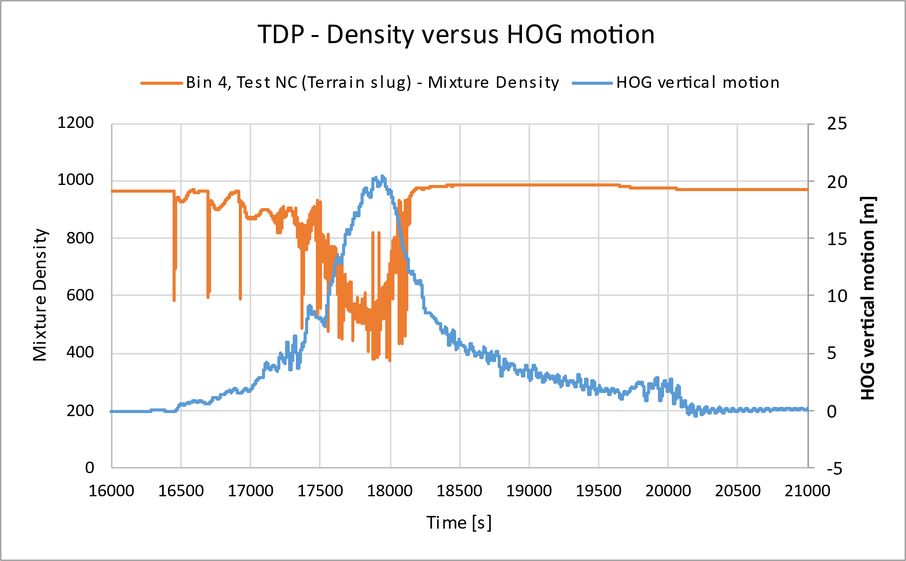
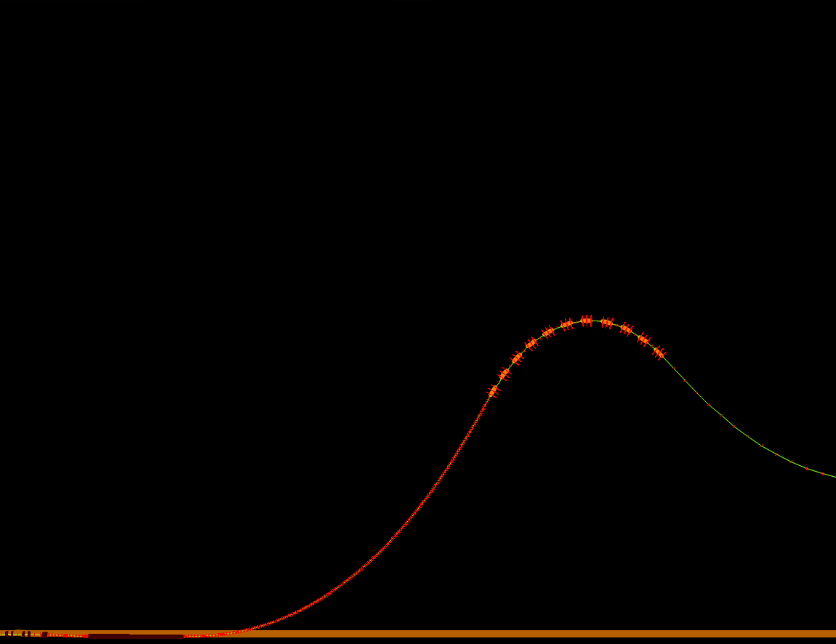
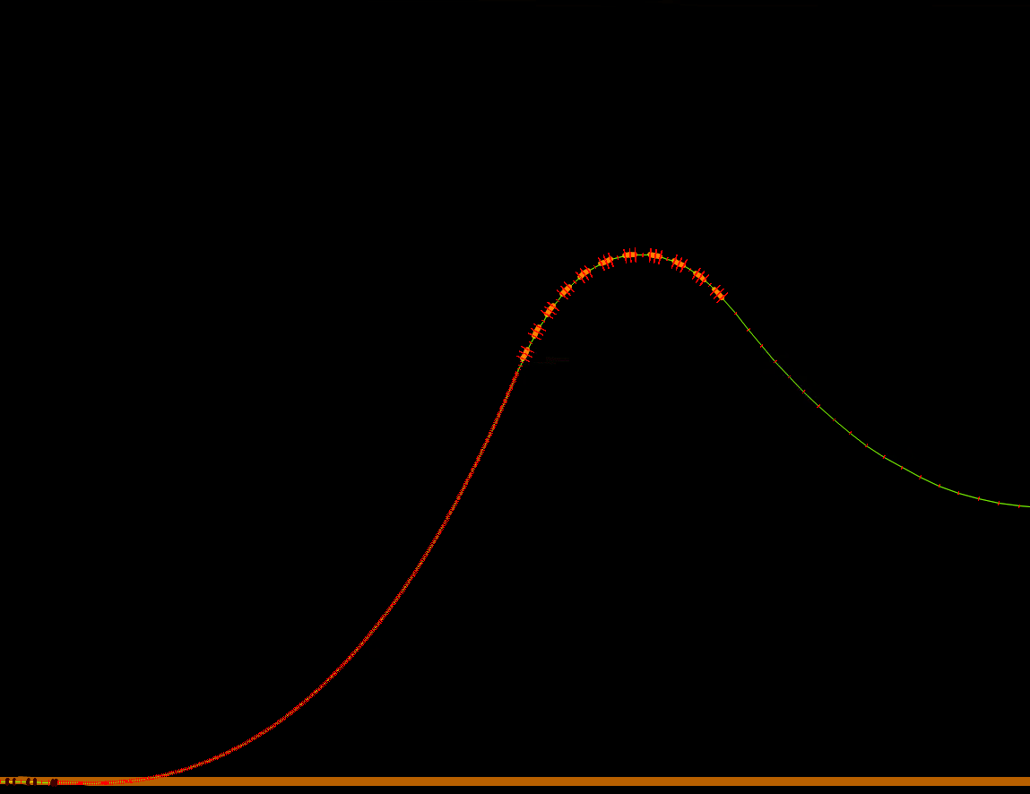
Global TDP Slugging Response
Bin 4 Test NC: Terrain slugging
Vertical movement of SAG is 20m
SAG clearance ranges from 27m to peak at 41m

Slide 17
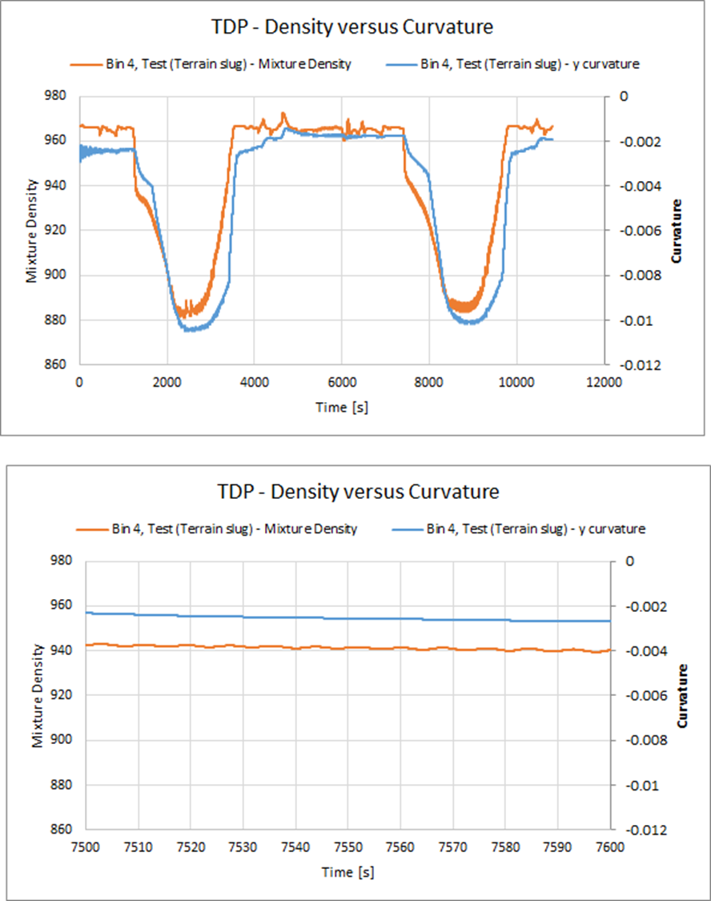
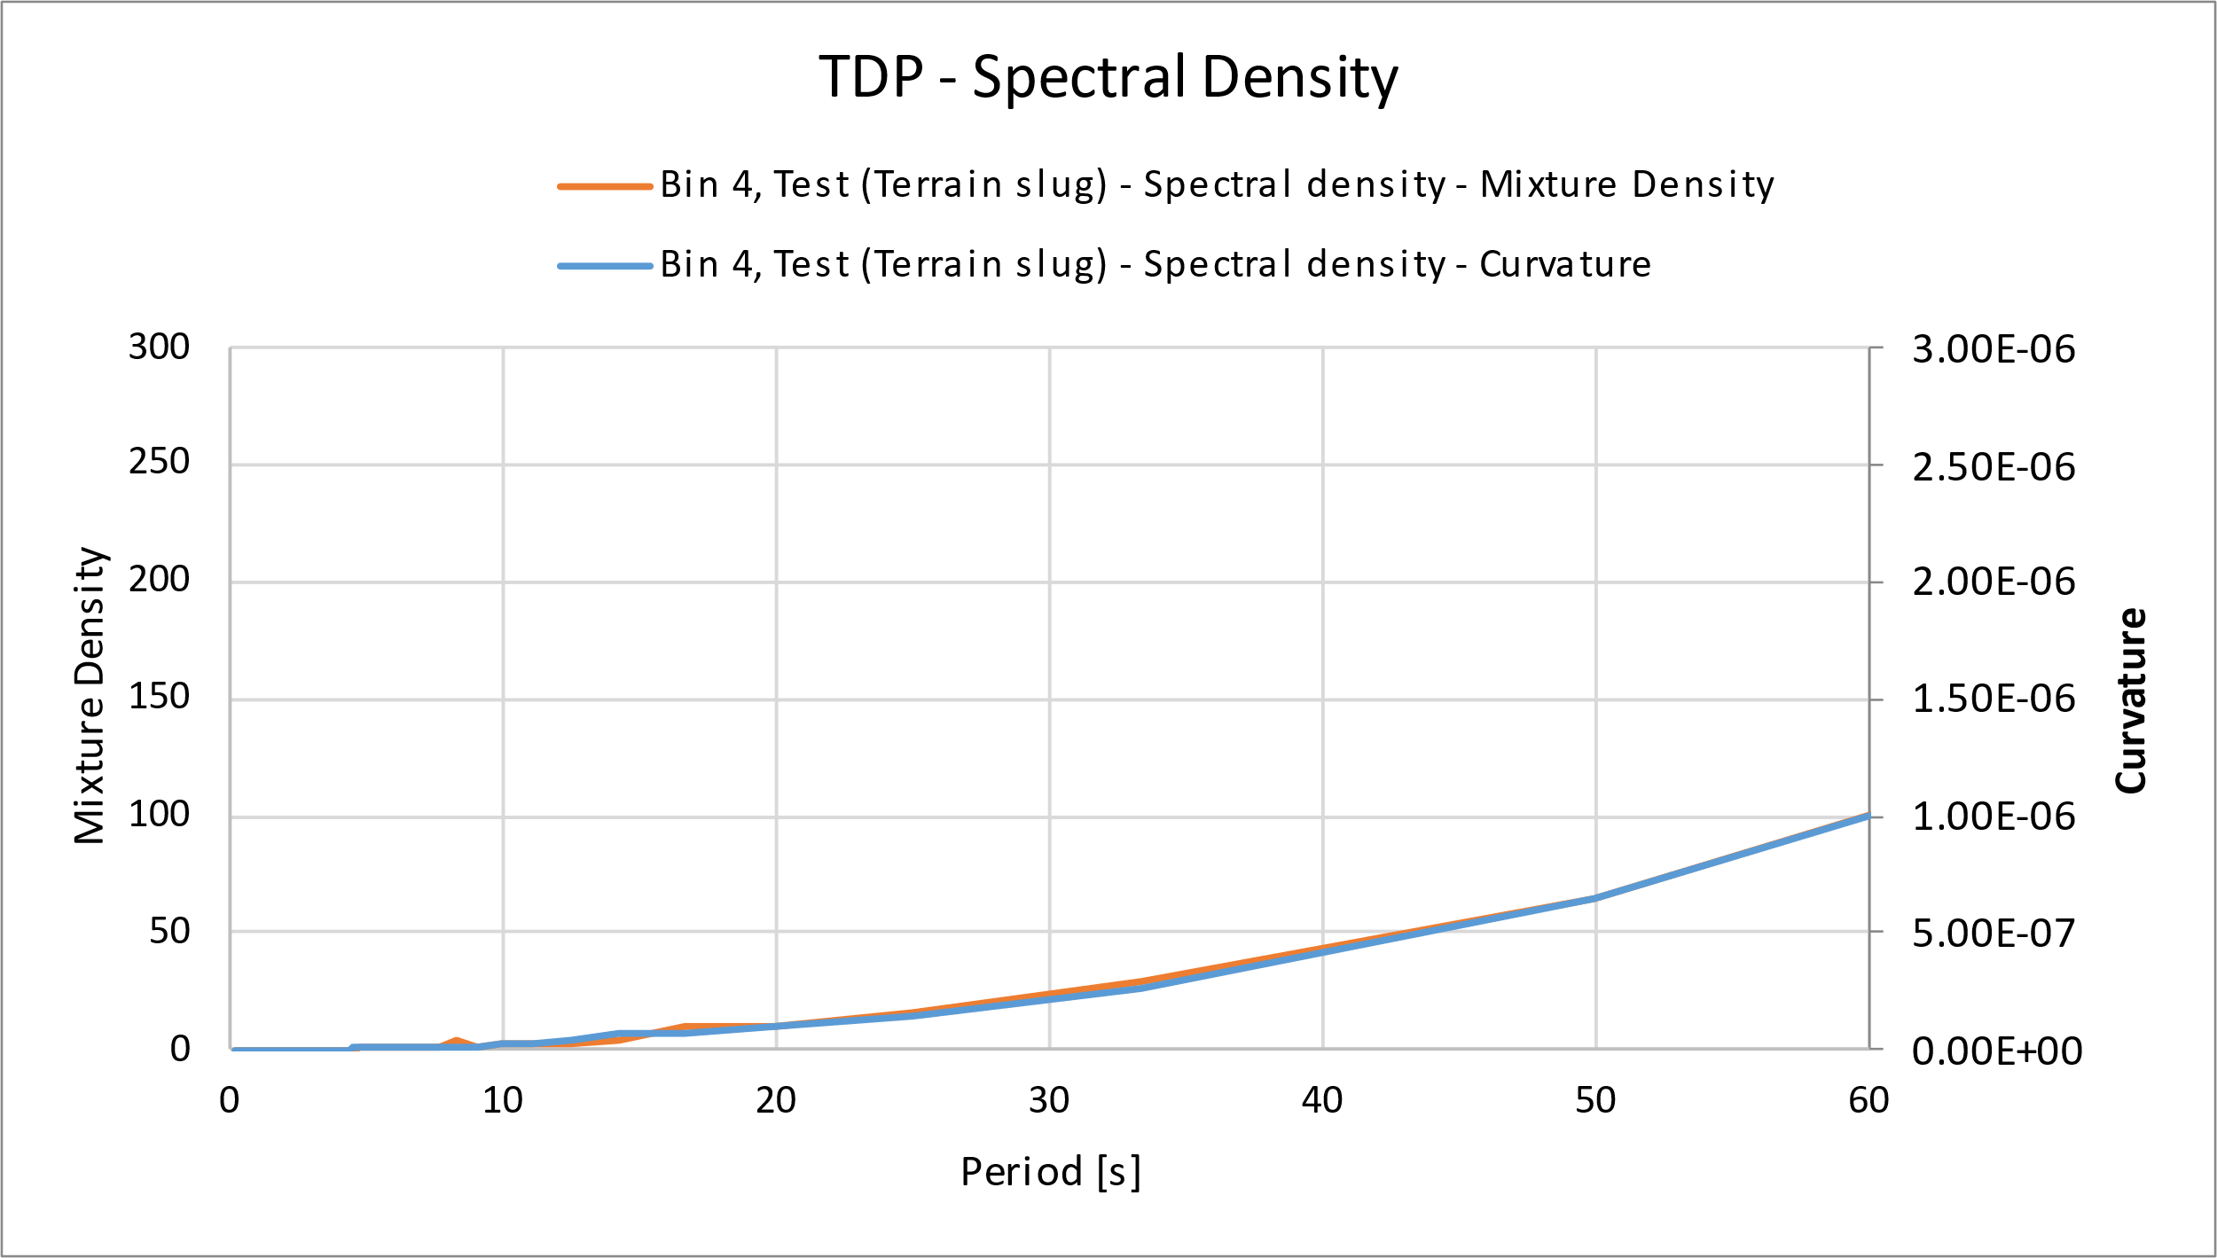
Global TDP Slugging Response
Bin 4 Test: Terrain slugging
Low fatigue life
Two slugs during 3 hours.
Note that global curvature responses are with flooded global hysteresis

Slide 18
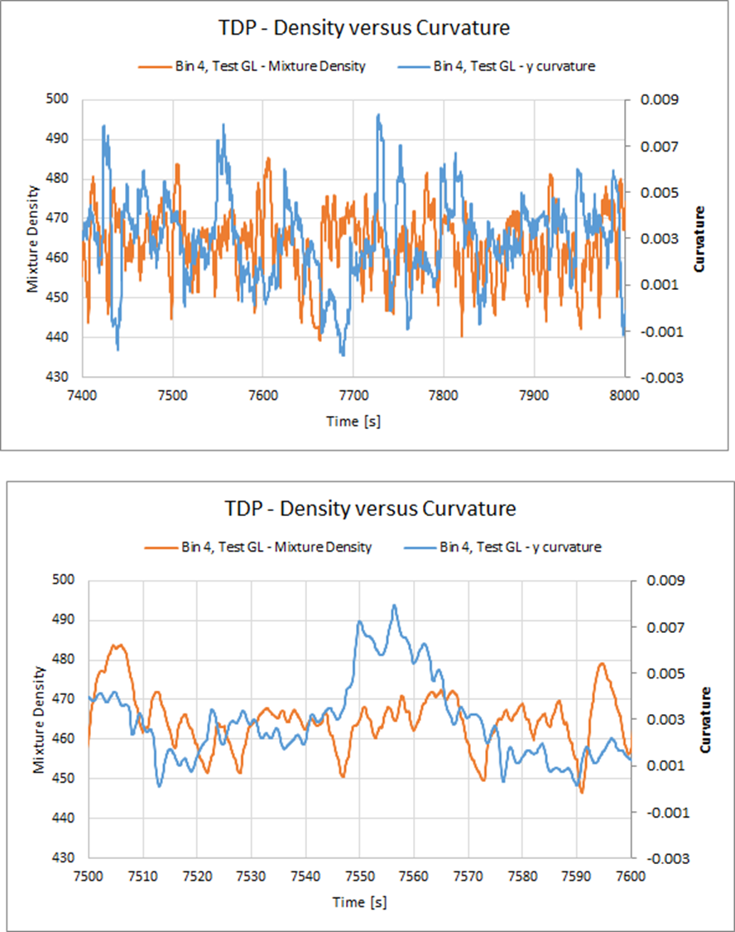
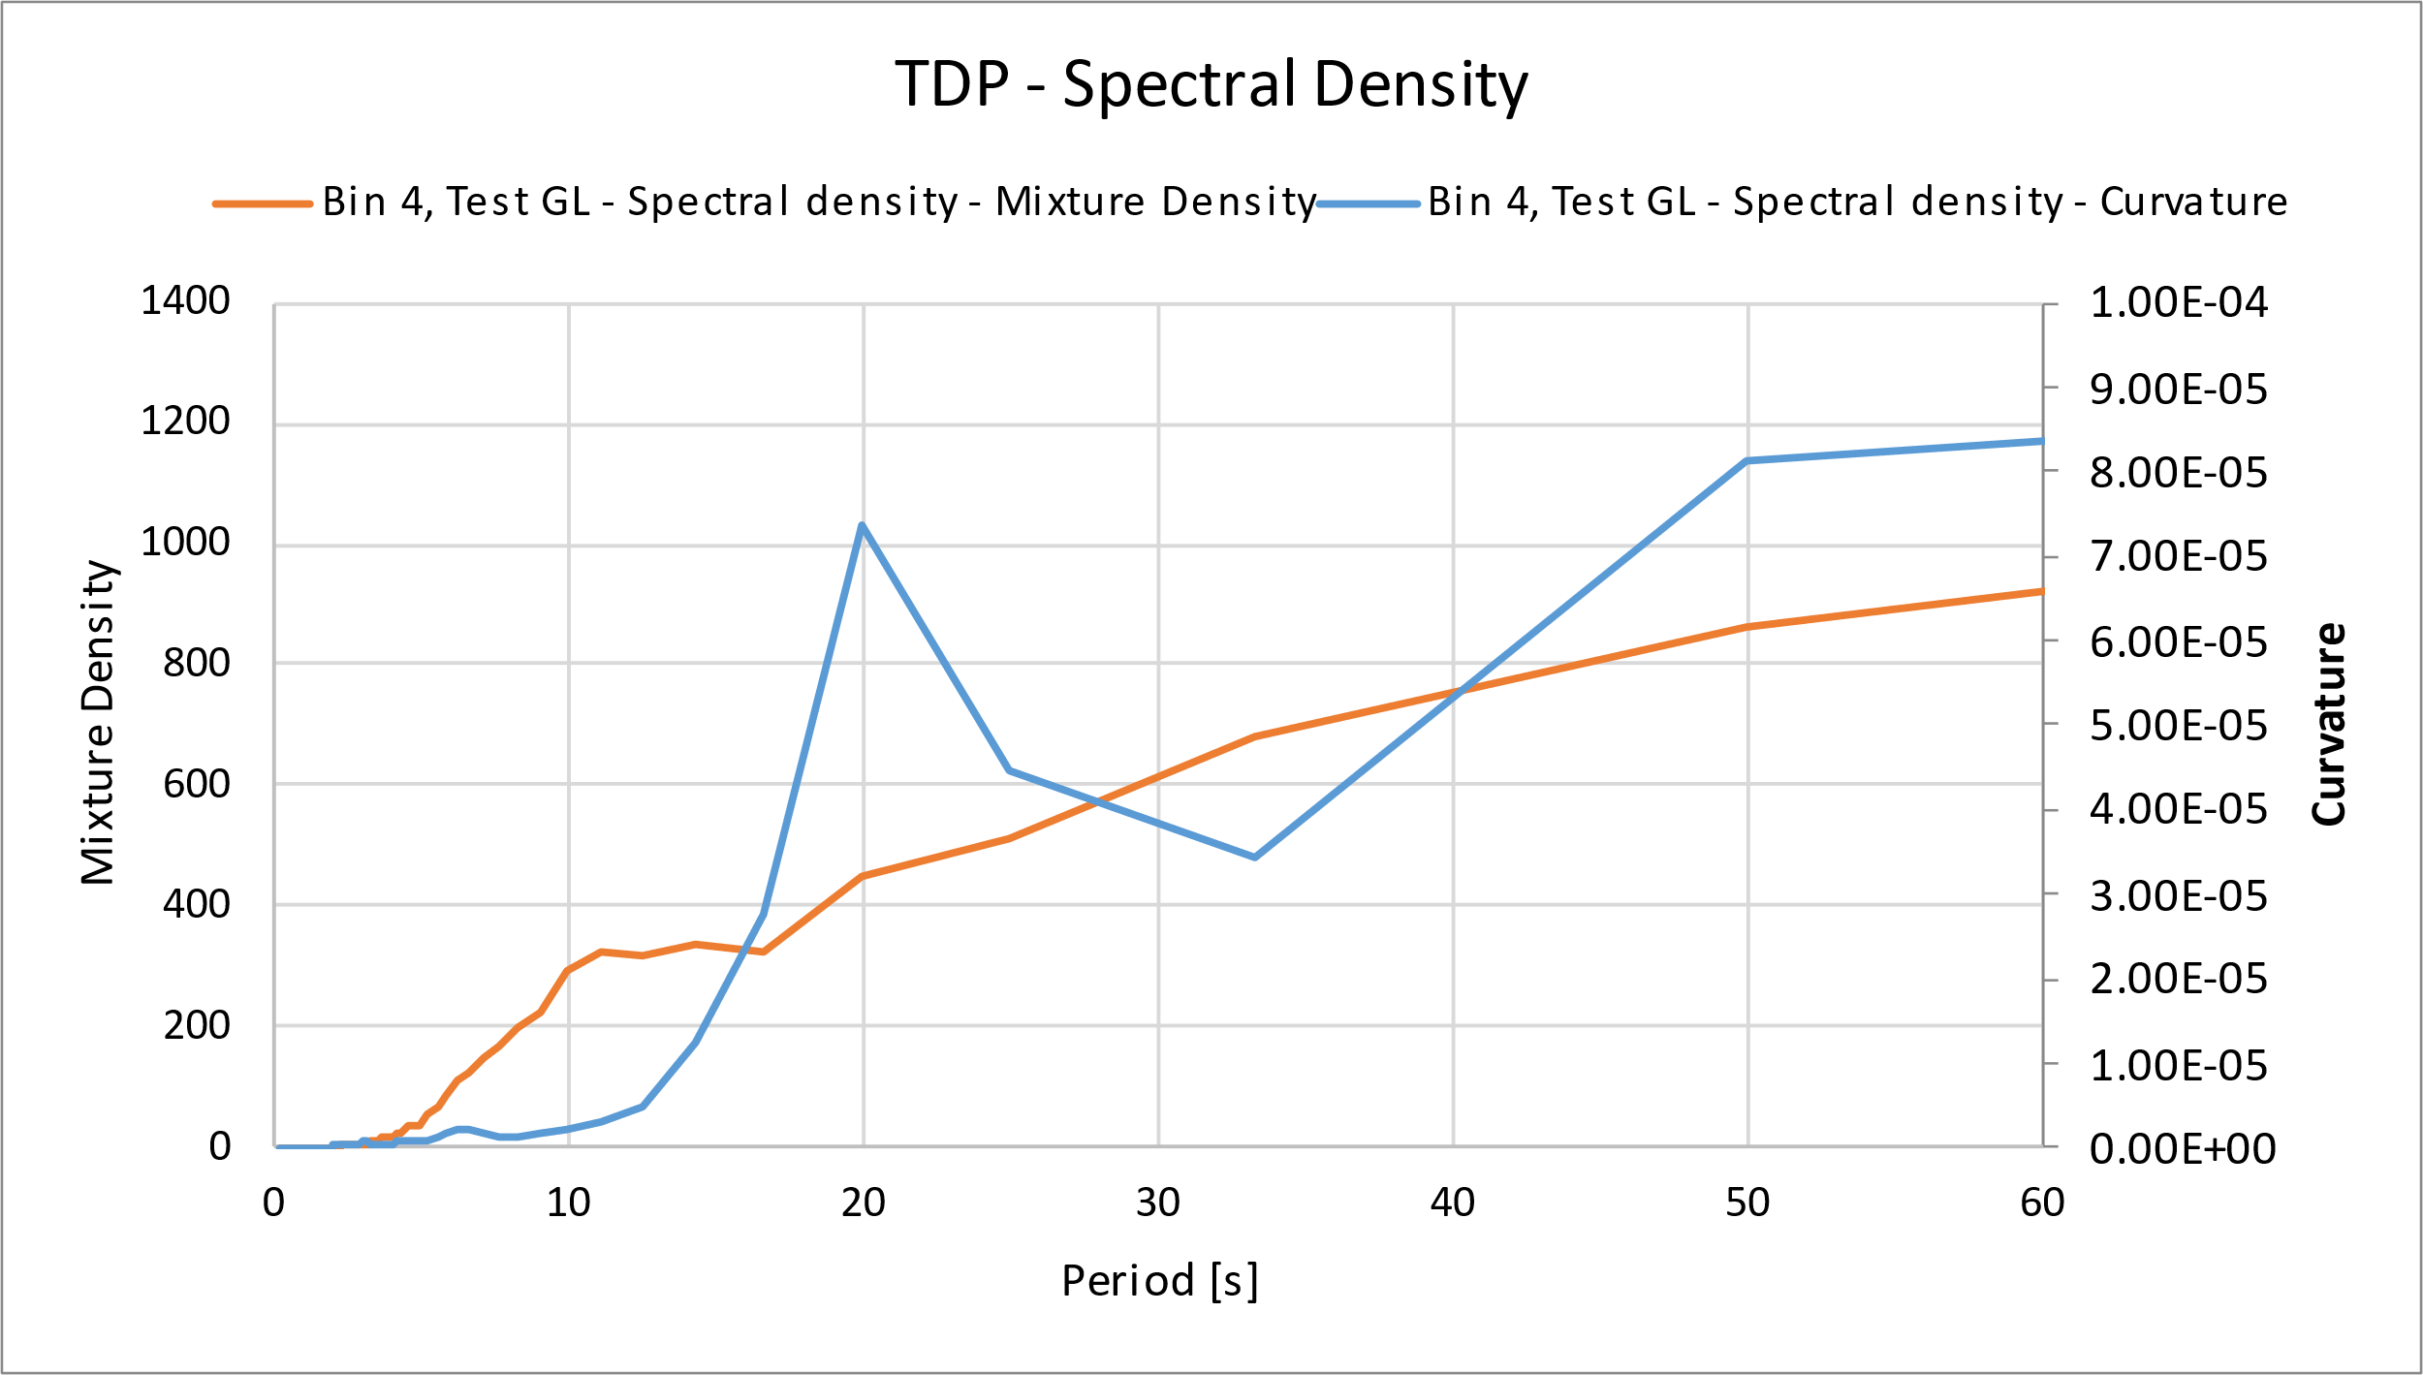
Global TDP Slugging Response
Bin 4 Test GL: Hydrodynamic slugging
Low fatigue life
Note that global curvature responses are with flooded global hysteresis

Slide 19
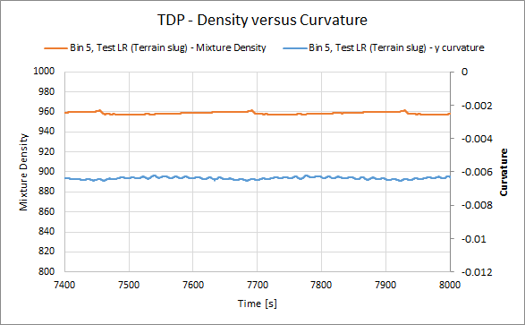
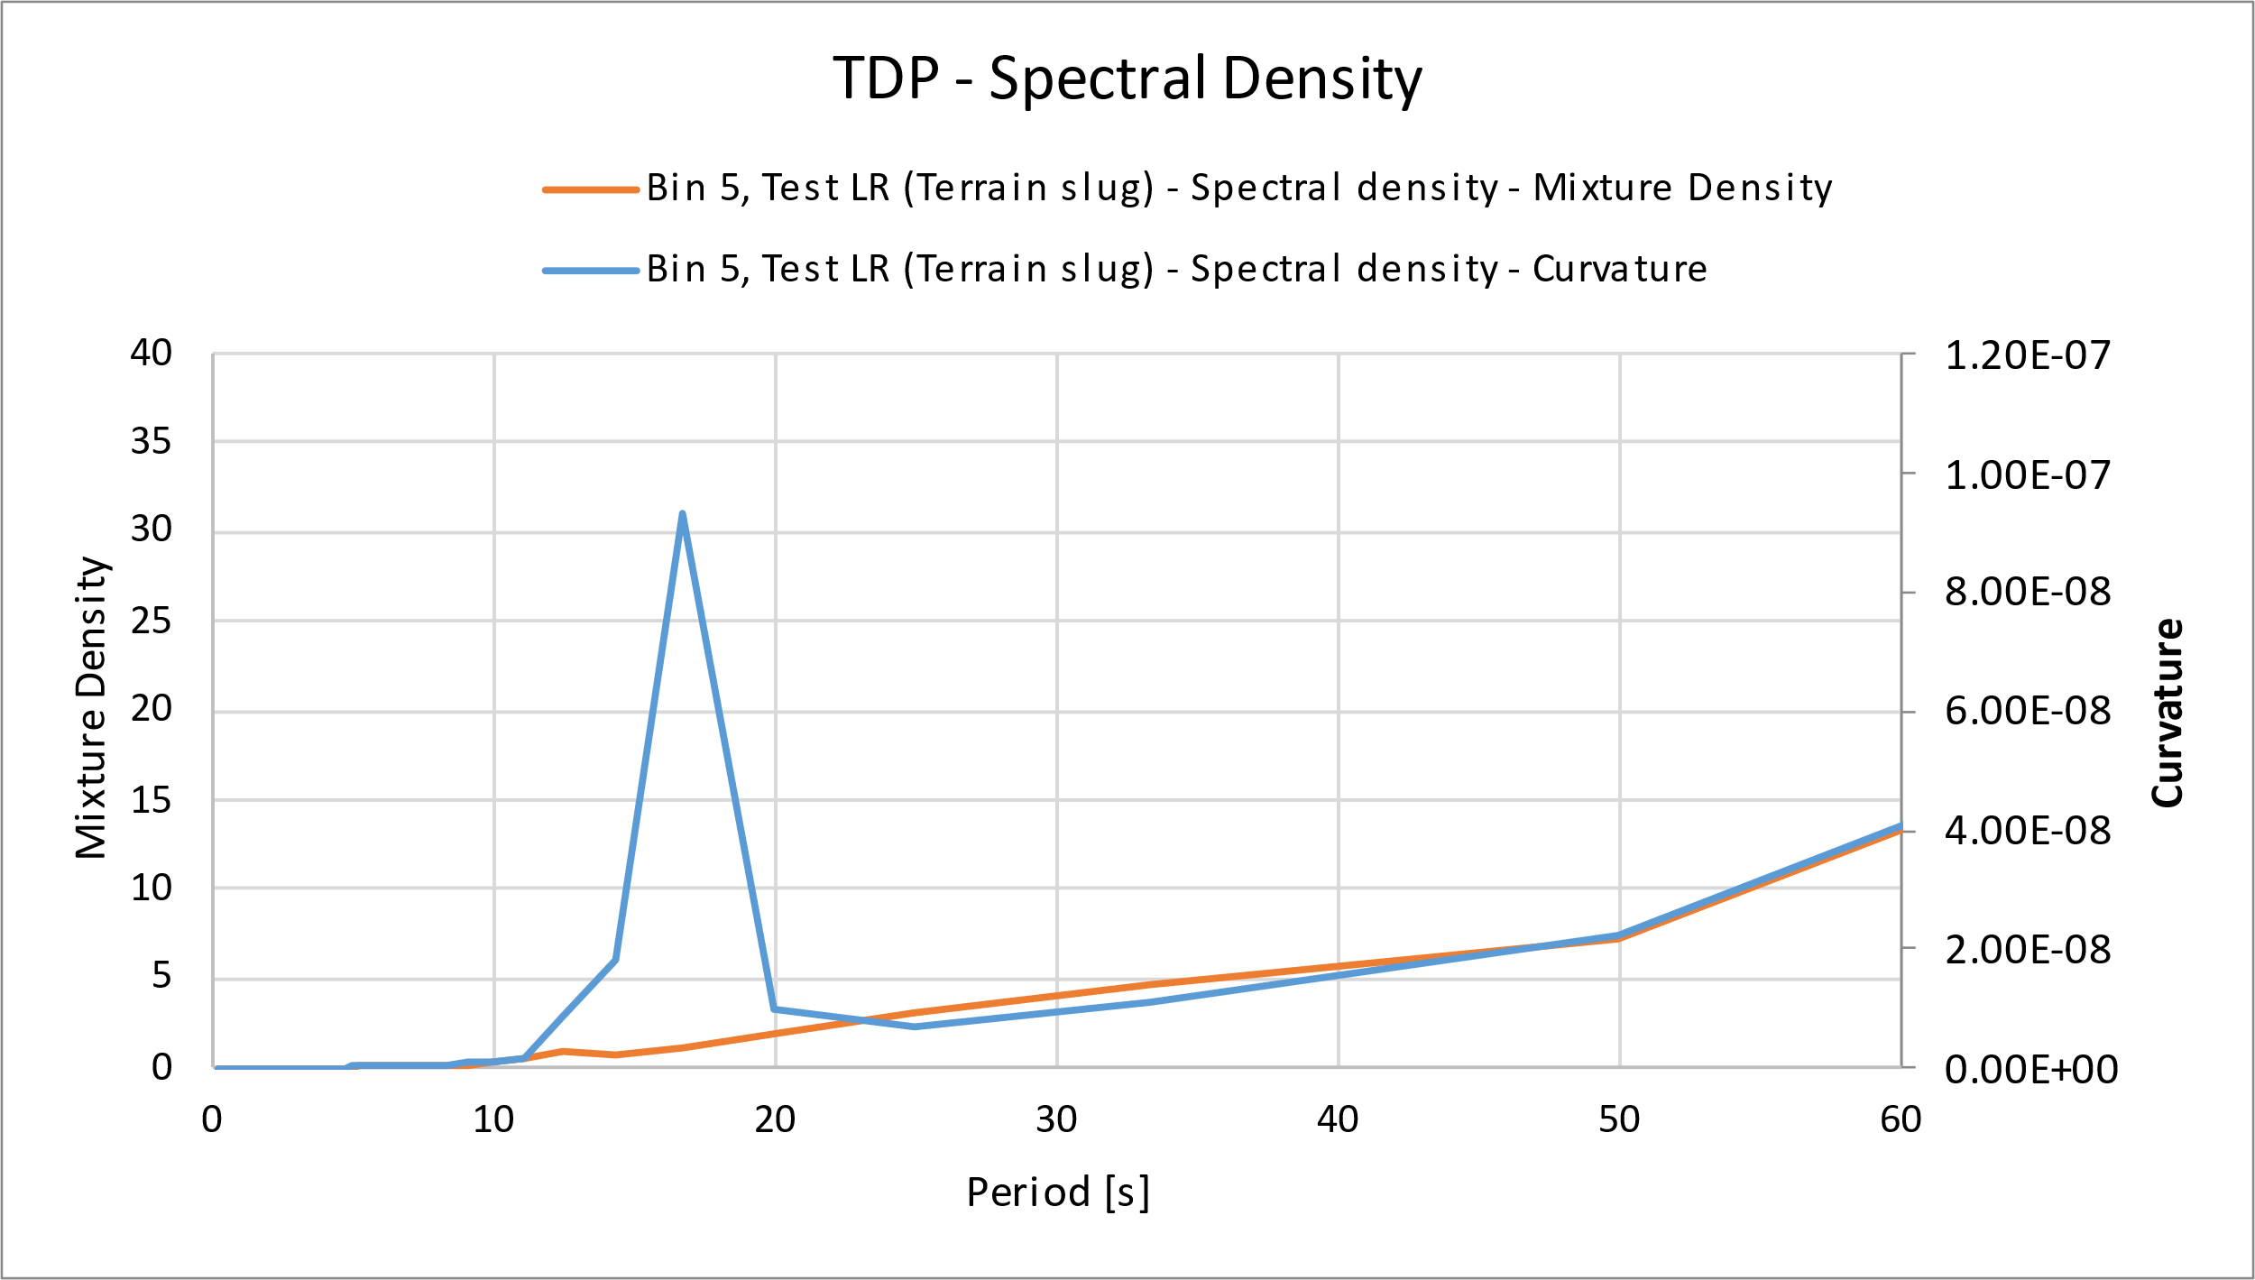
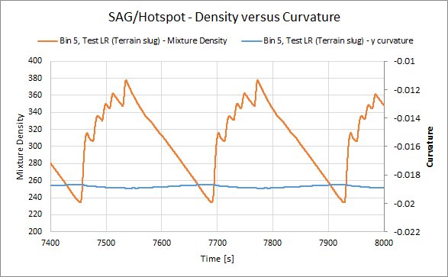
Global TDP Slugging Response
Bin 5 Test LR: Terrain slugging
High fatigue life
Slightly lower fatigue life is found in TDP versus SAG/hot spot for curvature/mixture density
Note that global curvature responses are with flooded global hysteresis

Slide 20
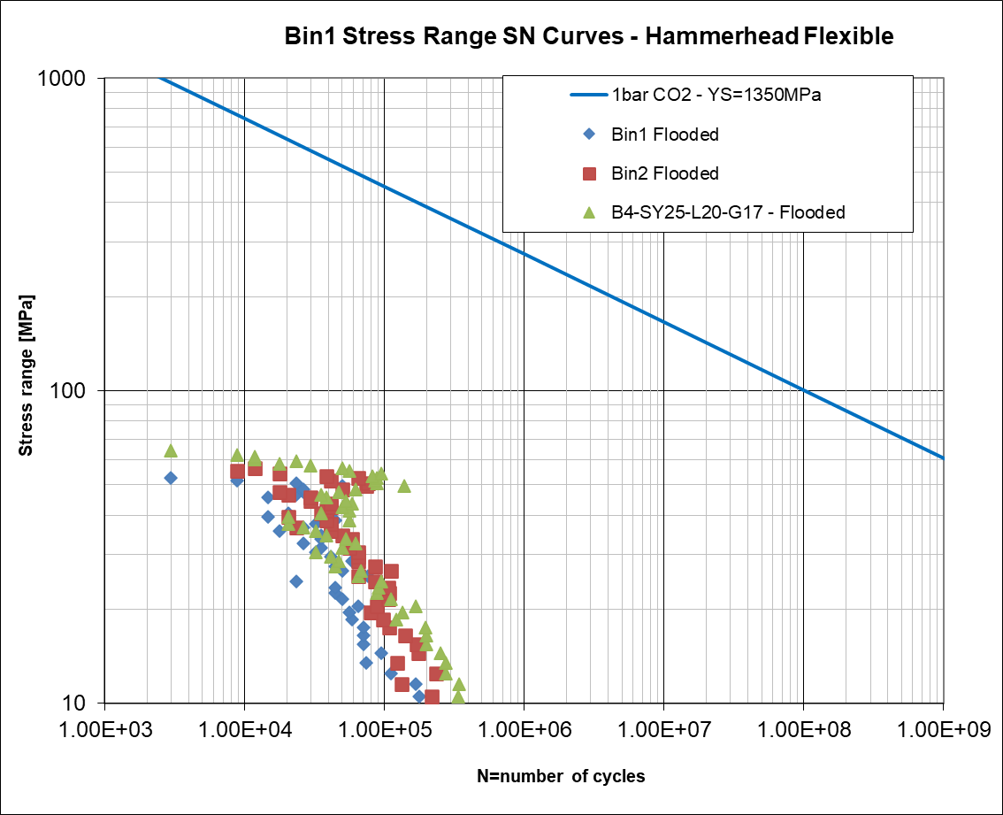
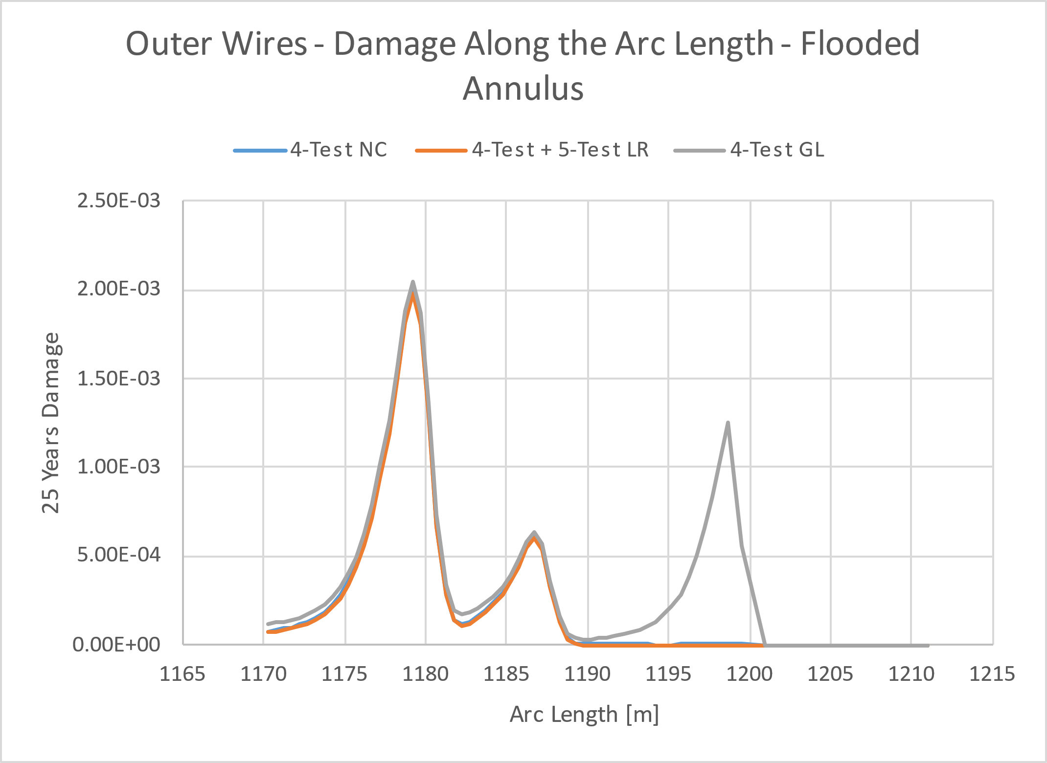
Slug Fatigue Analysis - Results
Note that: 1) Individual fatigue damage is with 100% probability at individual arc length hot spot. 2) The combined fatigue damage/life includes the probability for each bin and arc length hot spot is determined by combining all the relevant bins.
Fatigue results for Flooded Annulus Condition (SN curve 1bar CO2)
Flooded Global and Flooded Local, with 1bar CO2 SN curve

Slide 21
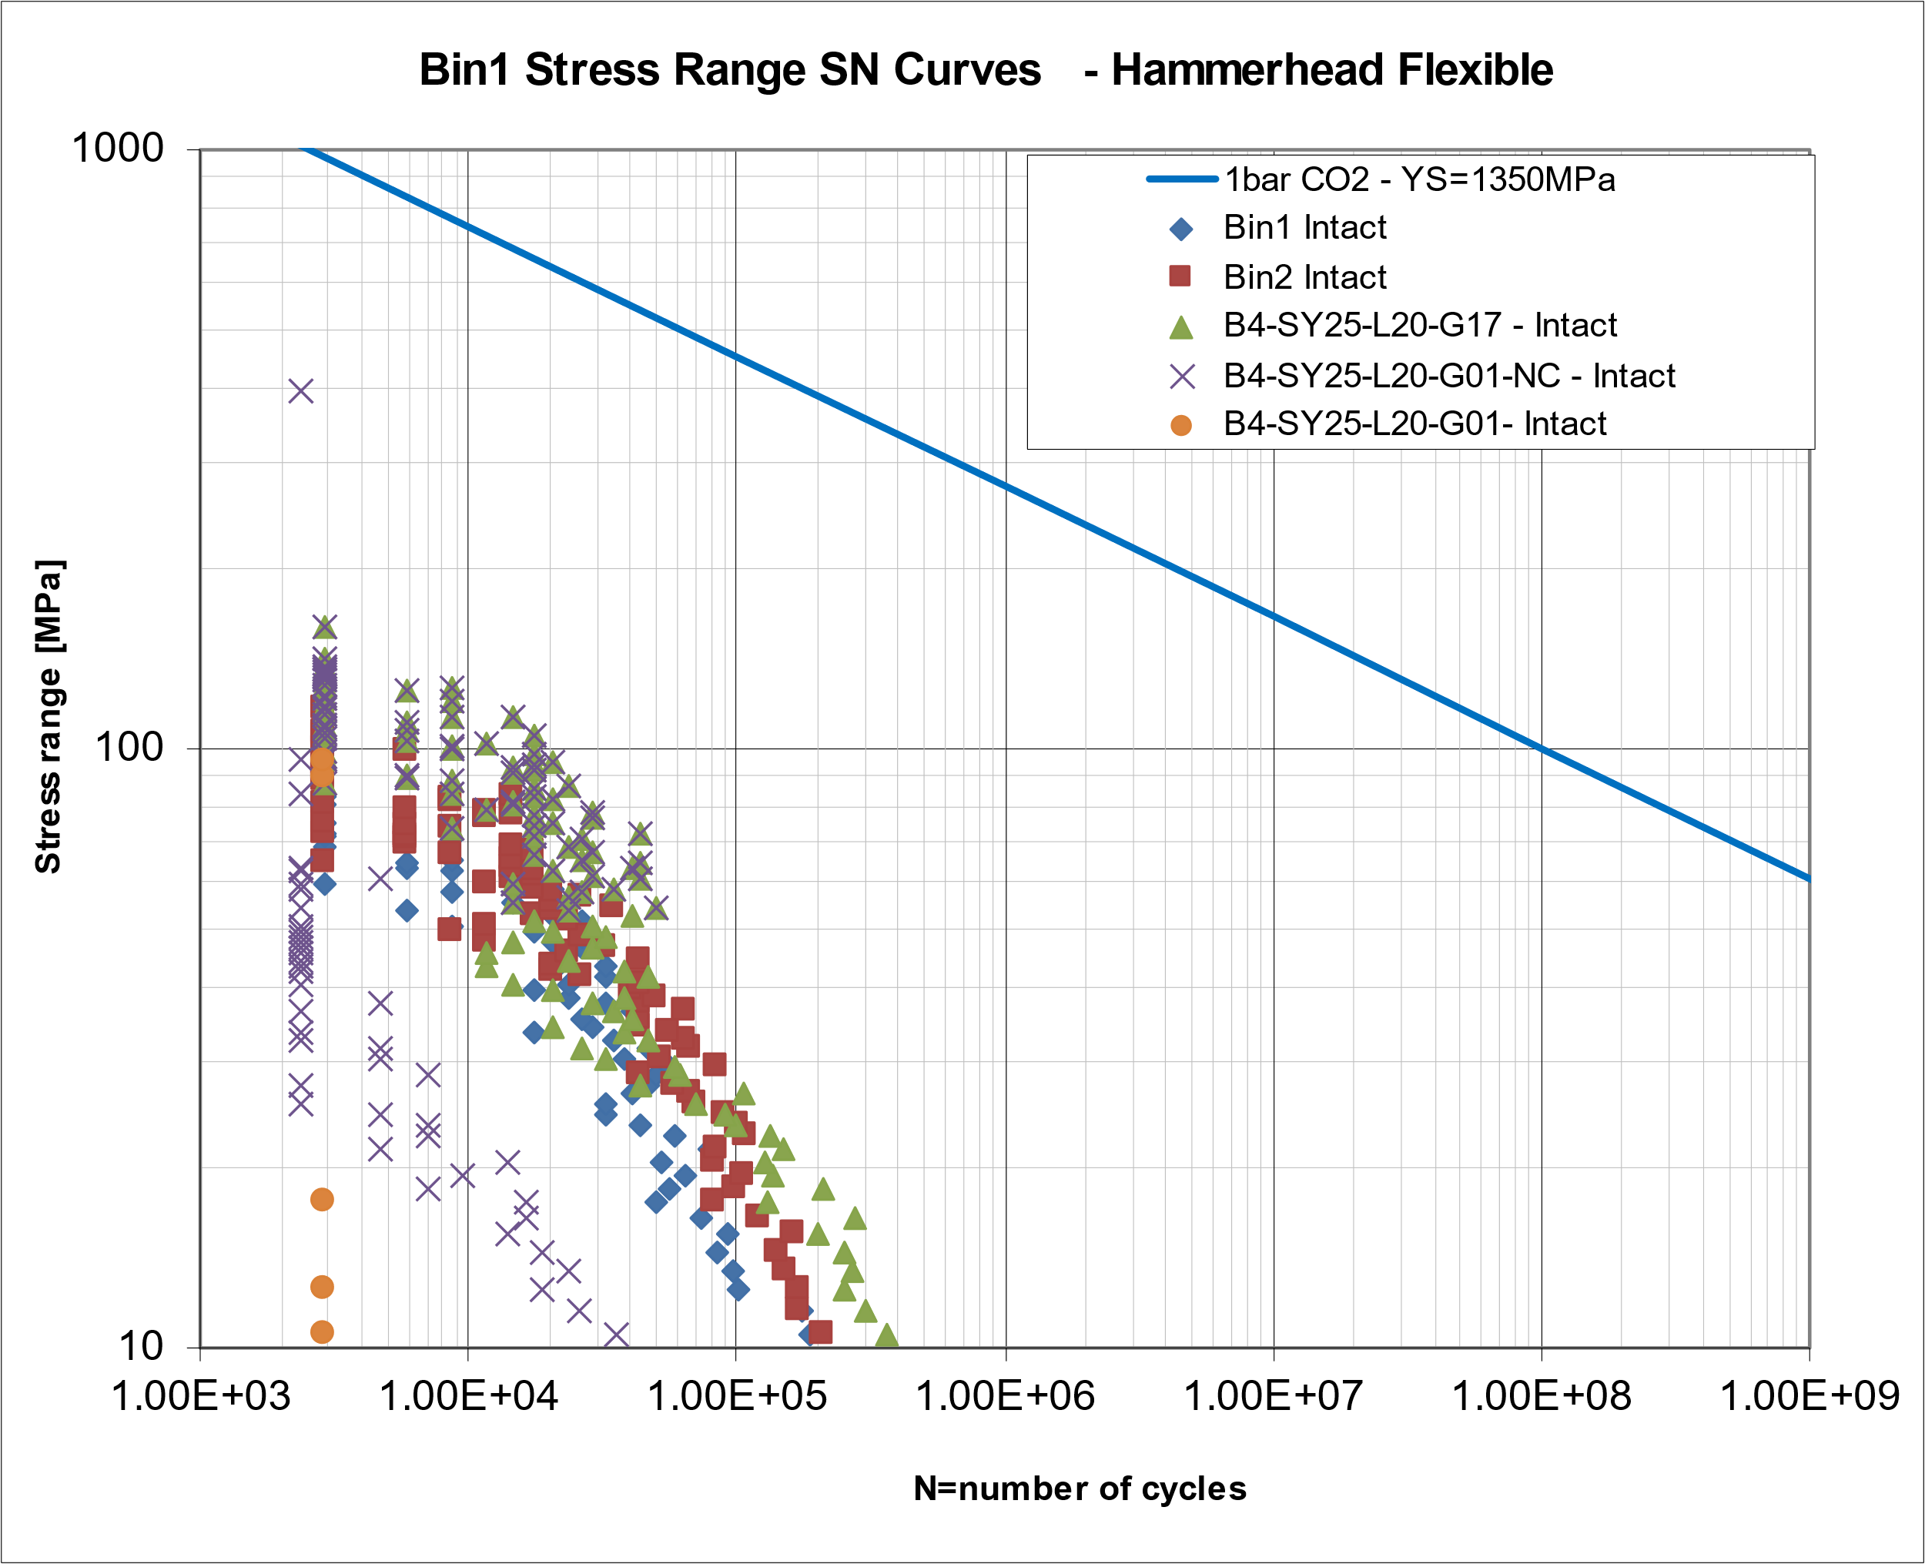
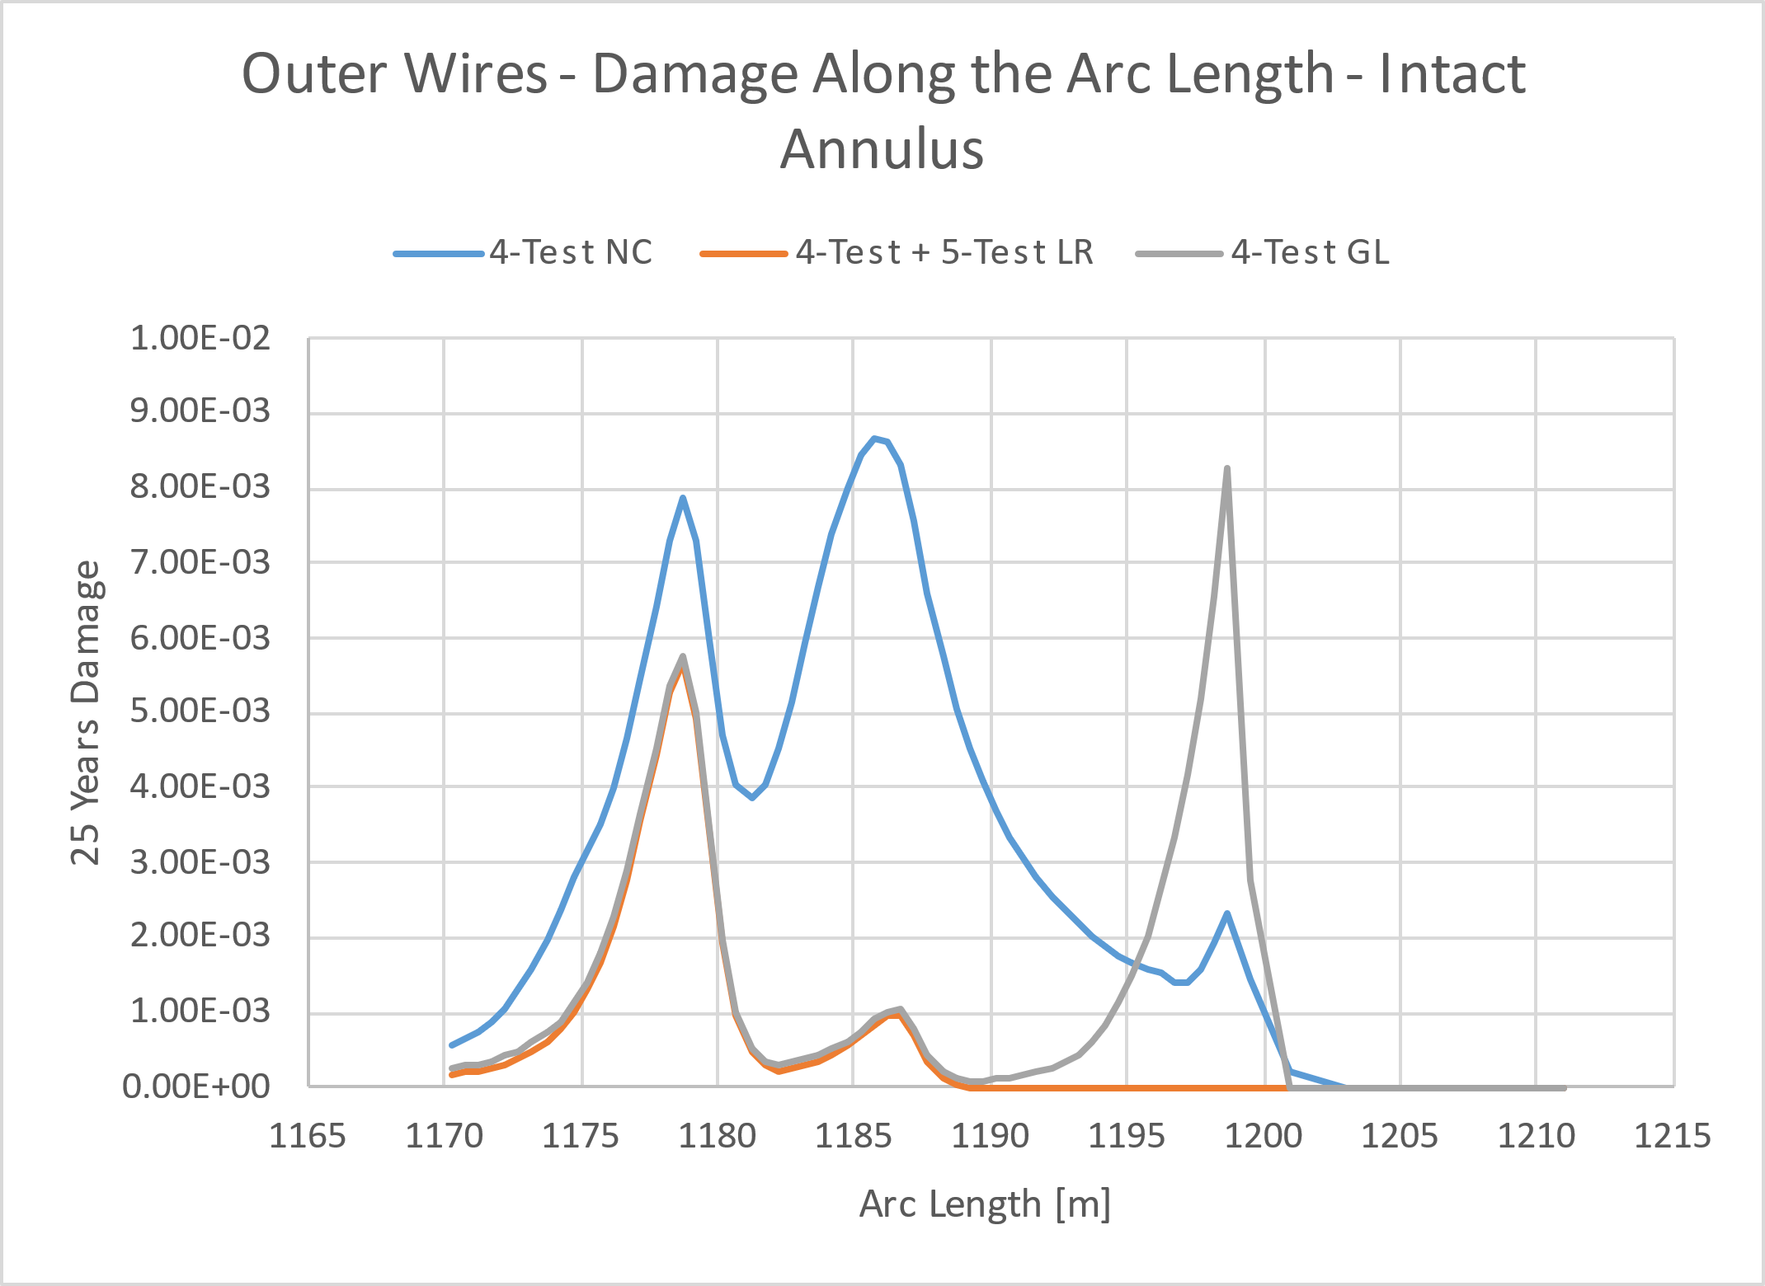
Slug Fatigue Analysis - Results
Note that: 1) Individual fatigue damage is with 100% probability at individual arc length hot spot. 2) The combined fatigue damage/life includes the probability for each bin and arc length hot spot is determined by combining all the relevant bins.
Fatigue results for Intact Annulus Condition (SN curve 1bar CO2)
Intact Global and Intact Local, with 1bar CO2 SN curve

Slide 22
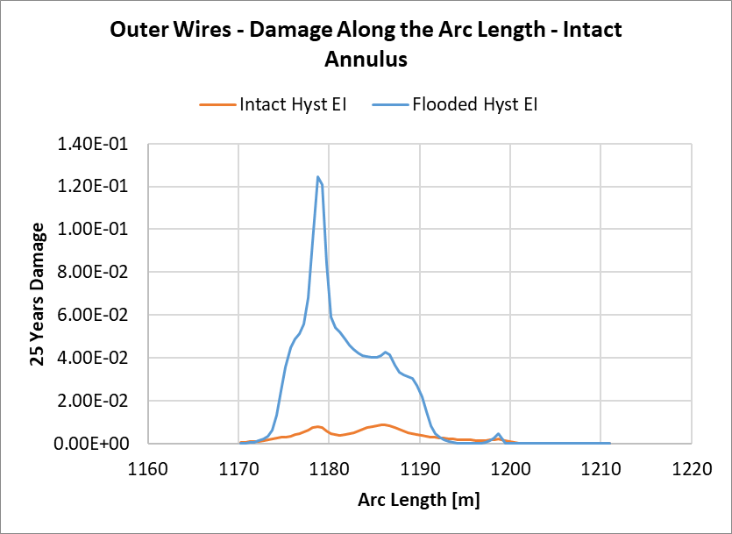
Slug Fatigue Analysis - Results
Fatigue results for Intact Annulus Condition (SN curve 1bar CO2)

Slide 23
Slug Fatigue Analysis - Results
Note that: 1) Individual fatigue damage is with 100% probability at individual arc length hot spot. 2) The combined fatigue damage/life includes the probability for each bin and arc length hot spot is determined by combining all the relevant bins.
Fatigue results for Intact and Dry Annulus Condition (SN curve in air)
Intact Global and Intact Local, with Marintek In Air SN Curve
Intact Global and Intact Local, with 1bar CO2 SN curve

Slide 24

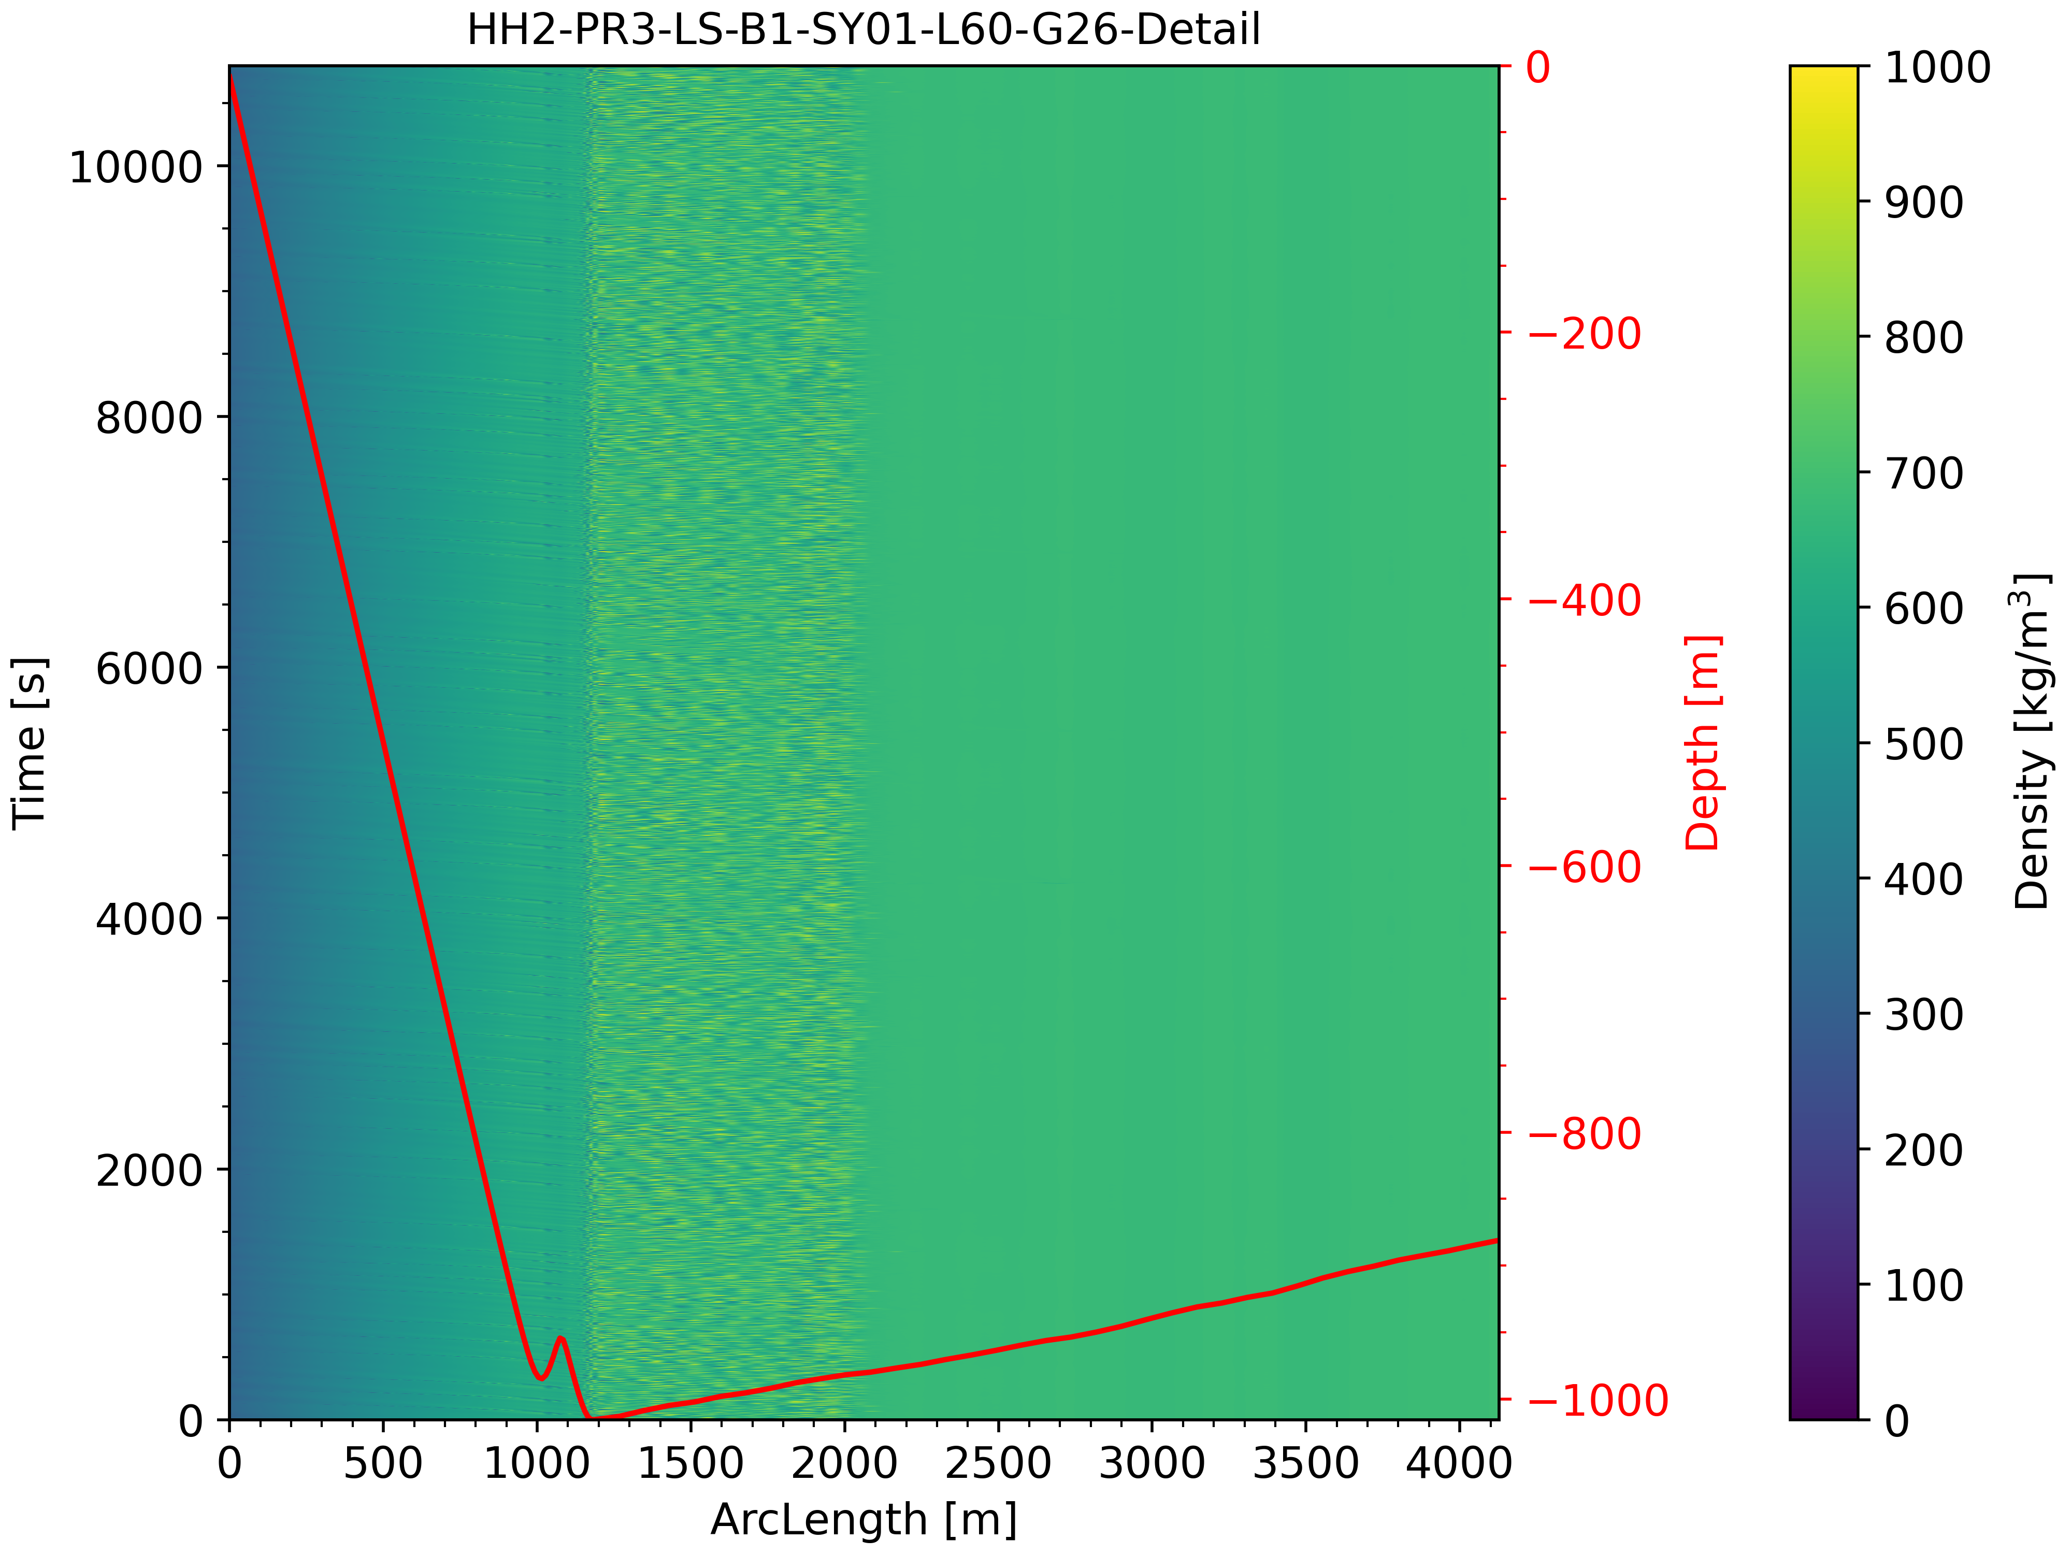
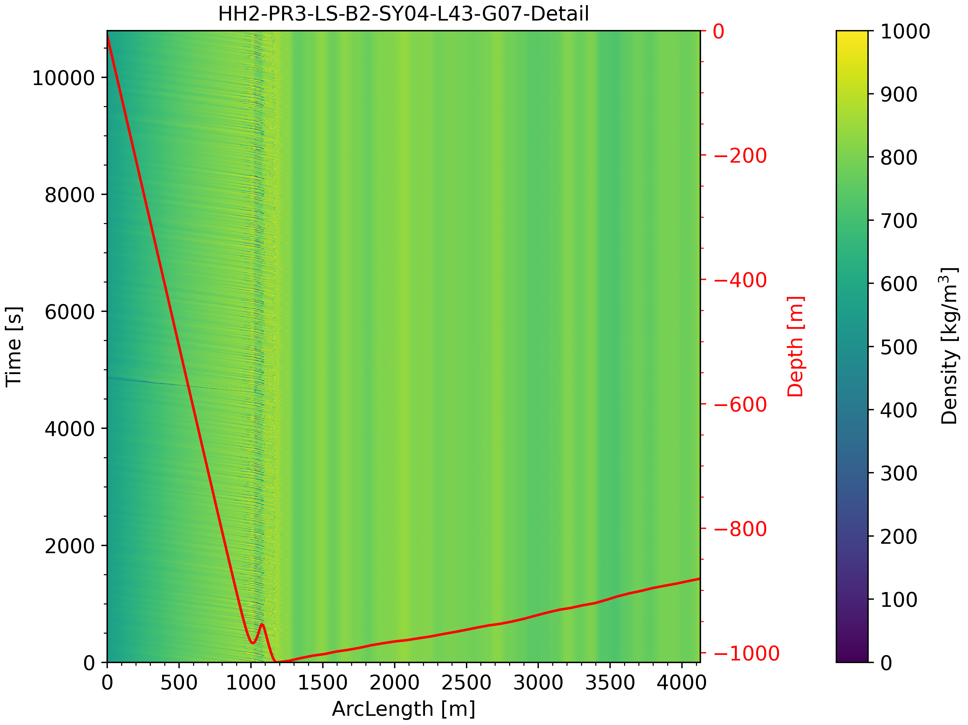
Slugging heatmaps
Slugging heatmaps
1-Early
2-Mid
No Slug

Slide 25
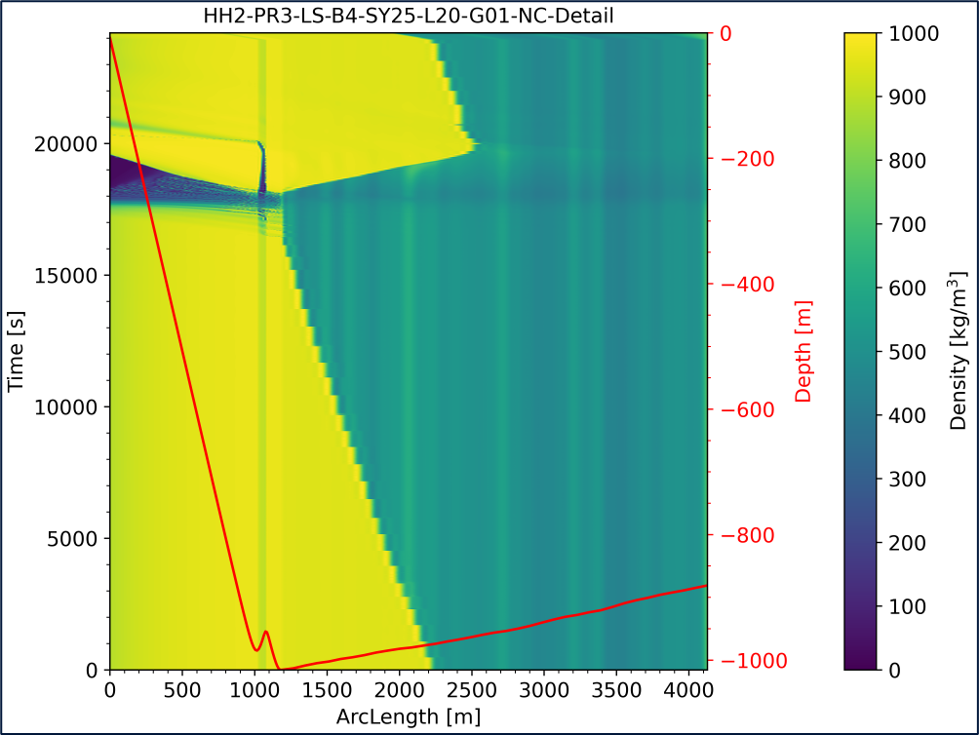
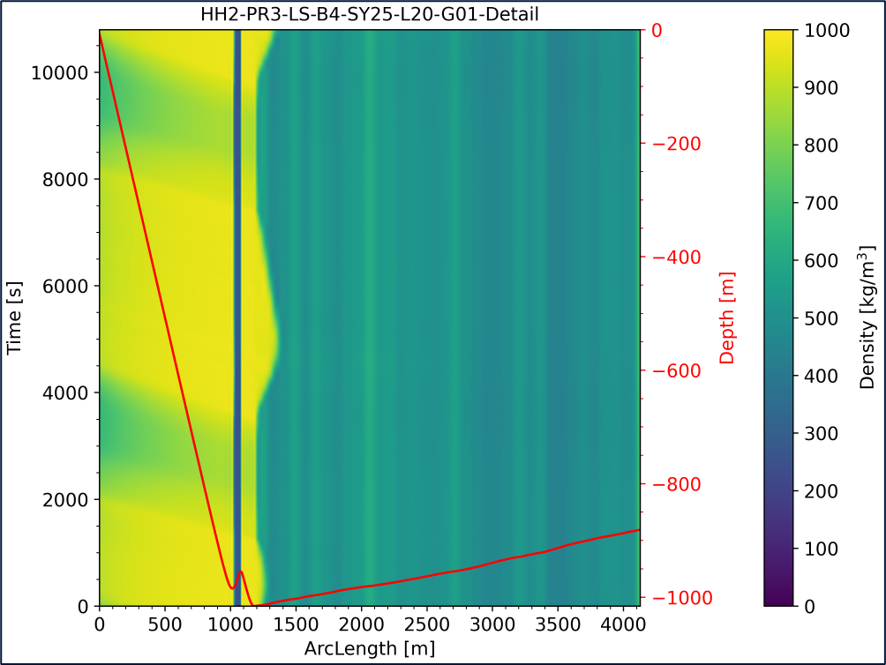
Slugging heatmaps
Slugging heatmaps
4-Test NC
4-Test
No Slug

Slide 26
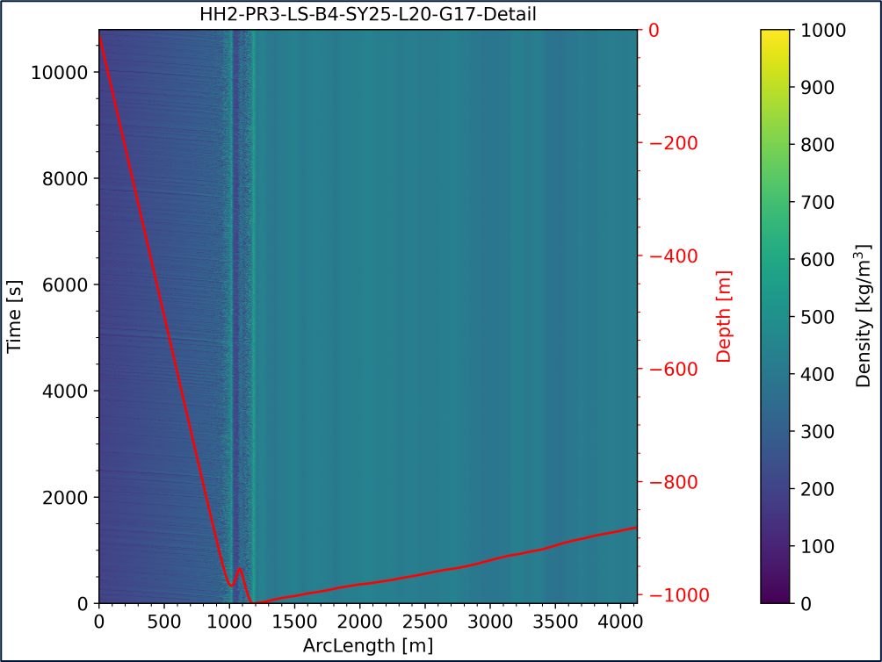
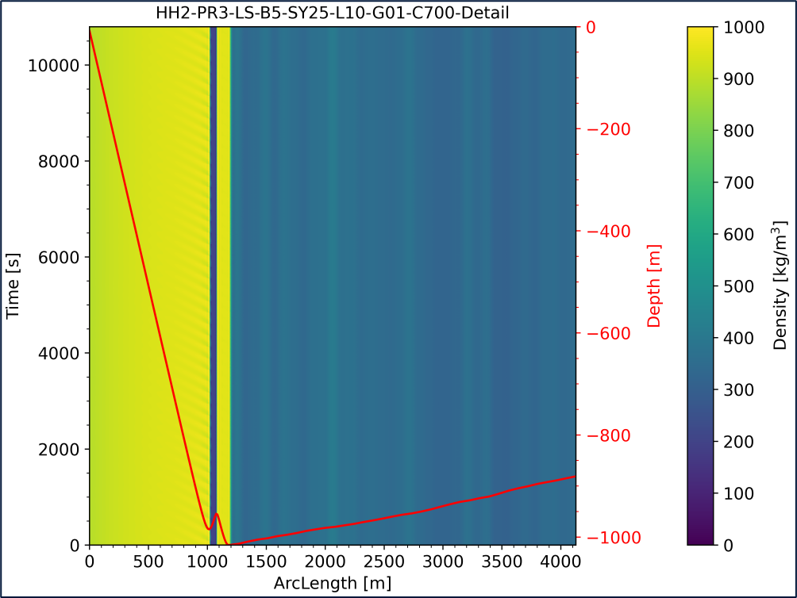
Slugging heatmaps
Slugging heatmaps
4-Test GL
5-Test LR
No Slug

Slide 27
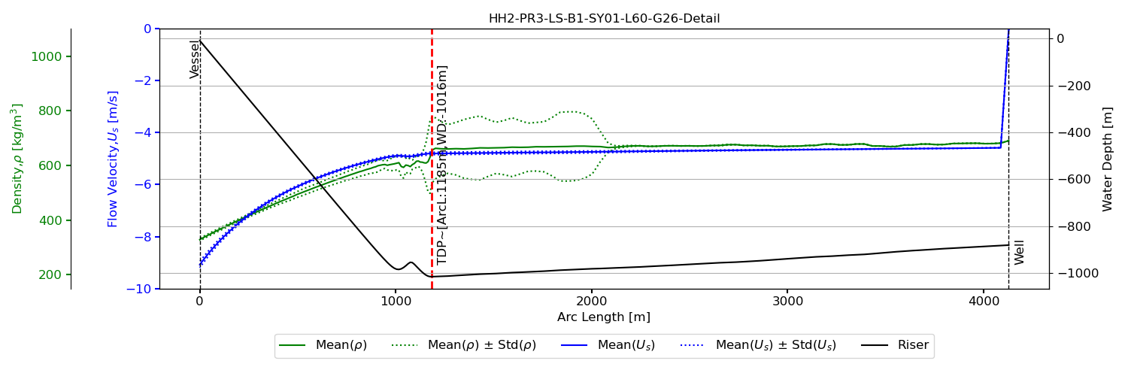
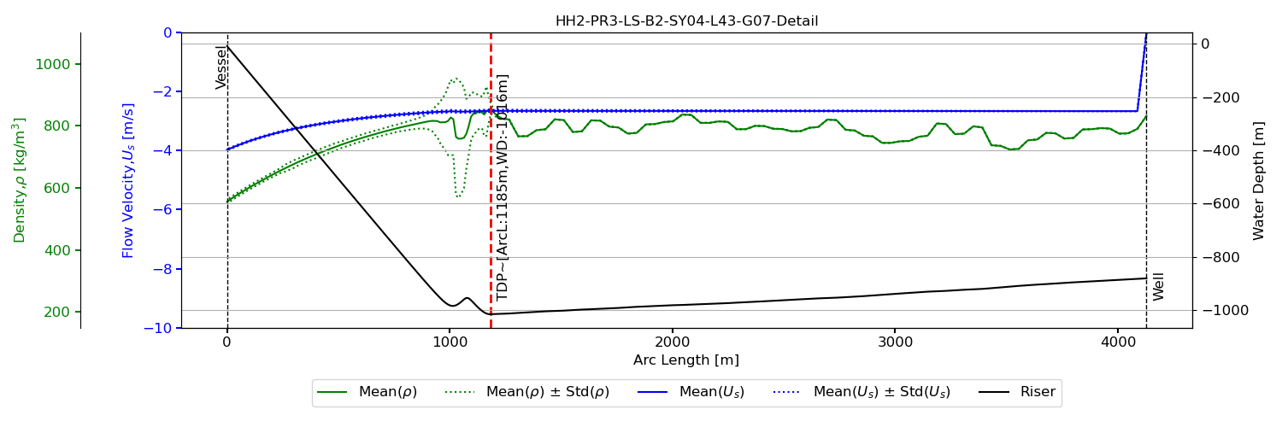

Riser | Bin | OrcaFlex Input for Mixture Density & Flow Velocity – Averaged over Time
PR3 | 1- Early
PR3 | 2- Mid
PR3 | 4- Test NC
No Slug

Slide 28



Riser | Bin | OFX Input for Mixture Density & Flow Velocity
PR3 | 4- Test
PR3 | 4- Test GL
PR3 | 5- Test LR
No Slug

